Slide 1
Foundations of Digital Logic
Boxi Wu / Xiaofei He
Zhejiang University

Slide 2
Overview
Introduction
Binary logic and gates
Transistors
Some IC parameters
Boolean algebra
Logic functions
Simplification of logic functions
Additional Gates and Circuits

Slide 3
Overview
Introduction
Binary logic and gates
Transistors
Some IC parameters
Boolean algebra
Logic functions
Simplification of logic functions
Additional Gates and Circuits

Slide 4
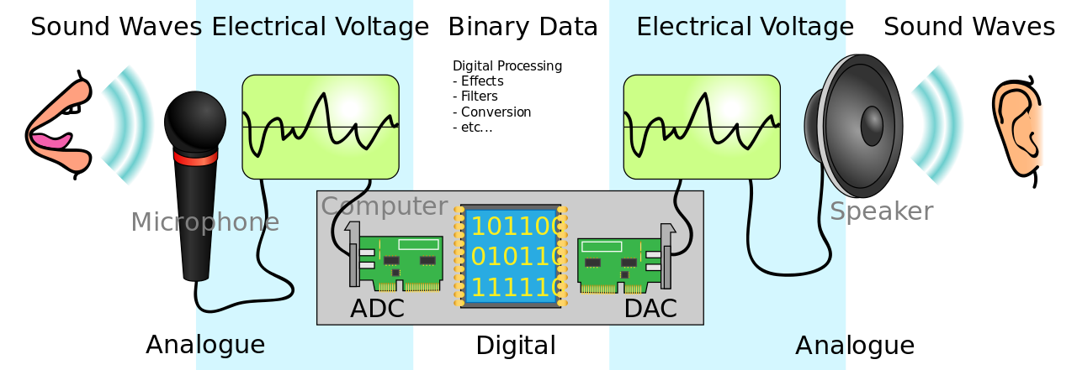
Electronic Systems
Analog signals vs. Digital signals
Notes:
Most physical variables are continuous
Voltage on a wire
Frequency of an oscillation
Position of a mass
Digital abstraction considers discrete subset of values
Abstraction: 物理（电子）-> 器件（晶体管）->模拟电路（放大器）->数字电路（或门）->逻辑（加法器、存储器）->微体系结构（数据通路、控制器）->体系结构（指令、寄存器）

Slide 5
Why Digital?
Intentionally restrict design choices
Example: Digital discipline
  Discrete voltages instead of continuous
  Simpler to design than analog circuits – can build more sophisticated systems
  Digital systems replacing analog predecessors:
    i.e., digital cameras, digital television, cell phones, CDs
Notes:
Discipline：设计的内在限制，可以更有效地在更高的抽象层次工作。如数字电路和模拟电路，前者使用离散电压，后者使用连续电压，因此数字电路是模拟电路的子集；能力弱但设计简单，更容易将组件组合成复杂的系统。

Slide 6
Overview
Introduction
Binary logic and gates
Transistors
Some IC parameters
Boolean algebra
Logic functions
Simplification of logic functions
Additional Gates and Circuits

Slide 7
Binary Logic and Gates
Binary variables take on one of two values.
Logical operators operate on binary values and binary variables.
Basic logical operators are the logic functions AND, OR and NOT.
Logic gates implement logic functions.
Boolean Algebra: a useful mathematical system for specifying and transforming logic functions.
We study Boolean algebra as a foundation for designing and analyzing digital systems!

Slide 8
Binary Variables
Recall that the two binary values have different names:
  True/False
  On/Off
  Yes/No
  1/0
We use 1 and 0 to denote the two values.
Variable identifier examples:
  A, B, y, z, or X

Slide 9
Logical Operations
The three basic logical operations are:
  AND
  OR
  NOT
AND is denoted by a dot (·).
OR is denoted by a plus (+).
NOT is denoted by an overbar ( ¯ ), a single quote mark (') after, or (~) before the variable.

Slide 10

Truth Table
A tabular listing of the values of a function for all possible combinations of values on its arguments
Example: Truth tables for the basic logic operations:
AND
OR
X | Y | Z = X+Y
0 | 0 | 0
0 | 1 | 1
1 | 0 | 1
1 | 1 | 1
NOT
X
Y
Z = X·Y
X
Z
=
$$\overline{X}$$
0
0
0
0
1
0
1
0
1
0
1
0
0
1
1
1

Slide 11
How to Model Logic Functions?
Using Switches
  For inputs:
    logic 1 is switch closed
    logic 0 is switch open
  For outputs:
    logic 1 is light on
    logic 0 is light off.
  NOT uses a switch such
  that:
    logic 1 is switch open
    logic 0 is switch closed
Switches in parallel => OR
Switches in series => AND
Normally-closed switch => NOT
C

Slide 12

An Example: Logic Using Switches
Light is on (L = 1) for
  L(A, B, C, D) =
  and off (L = 0), otherwise.
Useful model for relay circuits and for CMOS gate circuits, the foundation of current digital logic technology
B
$$C$$
A
D
Notes:
L (A, B, C, D) = A ((B C') + D) = A B C' + A D

Slide 13
Logic Gates
Perform logic functions:
  inversion (NOT), AND, OR, NAND, NOR, etc.
Single-input:
  NOT gate, buffer
Two-input:
  AND, OR, XOR, NAND, NOR, XNOR
Multiple-input
Notes:
Buffer：缓冲器，将一个“弱”逻辑信号转换为具有相同逻辑值的“强”逻辑信号的电路，时序不同。

Slide 14
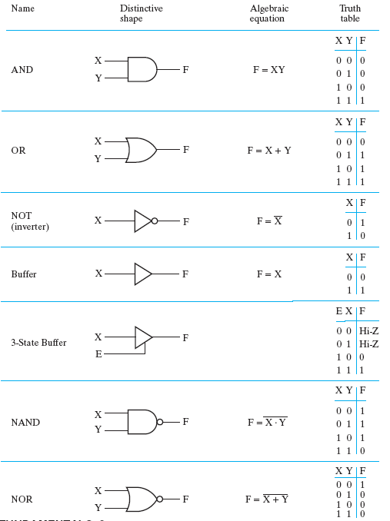
Other Gate Types
1. Graphics symbol and truth table for primitive gates
Primitive gate is simple and fast
Figure 2-28: primitive Digital Logic Gates

Slide 15
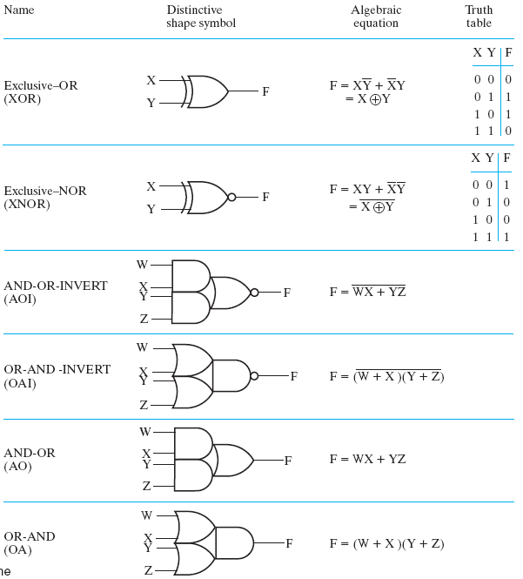
Other Gate Types
2. Graphics symbols and truth table for complex gates
Complex circuit Lower the cost and transmit time in circuit
Figure 2-29: Complex Digital Logic Gates

Slide 16
Single-Input Logic Gates

Slide 17
Single-Input Logic Gates

Slide 18
Two-Input Logic Gates

Slide 19
Two-Input Logic Gates

Slide 20
More Two-Input Logic Gates

Slide 21
More Two-Input Logic Gates
Notes:
XOR: 异或
XNOR：同或

Slide 22
Multiple-Input Logic Gates

Slide 23
Multiple-Input Logic Gates
Notes:
多输入异或：RC4

Slide 24
Overview
Introduction
Binary logic and gates
Transistors
Some IC parameters
Boolean algebra
Logic functions
Simplification of logic functions
Additional Gates and Circuits

Slide 25
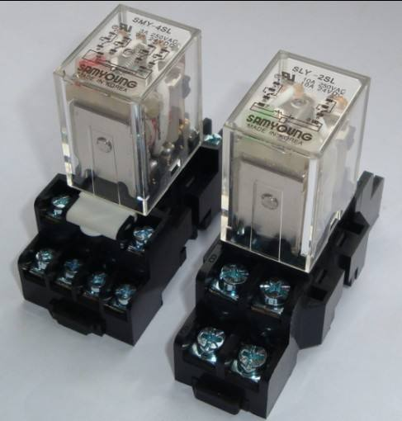
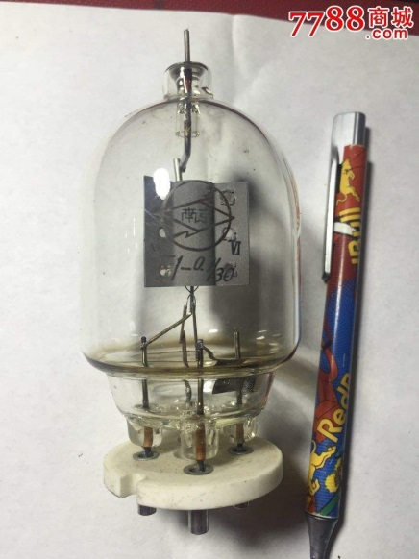
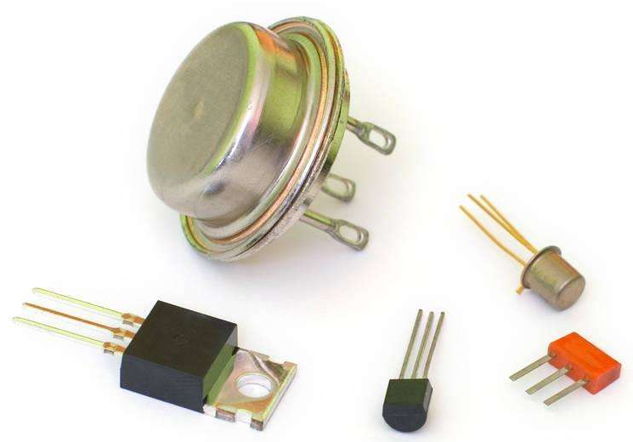
Relays vs. Vacuum Cube vs. Transistor
In the earliest computers, switches were opened and closed by magnetic fields produced by energizing coils in relays. The switches in turn opened and closed the current paths.
Later, vacuum tubes that open and close current paths electronically replaced relays.
Today, transistors are used as electronic switches that open and close current paths.
Notes:
‌真空管的工作原理‌主要基于电子在真空中的流动。真空管，也称为电子管，由阴极、栅极和阳极组成。当阴极被加热时，它会释放电子，栅极控制电子的流动，进而调节流向阳极的电流。
由于电子管在工作时必须用灯丝将阴极加热到数千度的高温以后，阴极才能发射出电子流，所以这种电子器件不仅体积大、笨重，而且耗电量大，寿命短，可靠性差。
晶体管(即半导体三极管)。由于它是一种固体器件，而且不需要用灯丝加热，所以不仅体积小、重量轻、耗电省，而且寿命长，可靠性也大为提高。
‌晶体管的工作原理基于PN结的单向导电性，通过控制电流的放大或开关来实现其功能‌。

Slide 26
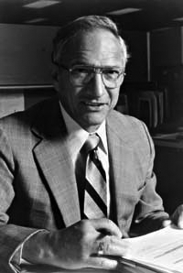
Robert Noyce, 1927-1990
Nicknamed “Mayor of Silicon Valley”
Cofounded Fairchild Semiconductor in 1957
Cofounded Intel in 1968
Co-invented the integrated circuit
Notes:
1947年12月16日：威廉·肖克利(William Shockley)、约翰·巴顿(John Bardeen)和沃特·布拉顿(Walter Brattain)成功地在贝尔实验室制造出第一个晶体管。
1950年：威廉·肖克利开发出双极晶体管(Bipolar Junction Transistor)，这是现在通行的标准的晶体管。
1953年：第一个采用晶体管的商业化设备投入市场，即助听器。
1954年10月18日：第一台晶体管收音机Regency TR1投入市场，仅包含4只锗晶体管。
1958年：集成电路 杰克·基尔比（Jack Kilby）and 罗伯特·诺伊斯(Robert Noyce)
1961年4月25日：第一个集成电路专利被授予罗伯特·诺伊斯(Robert Noyce)。最初的晶体管对收音机和电话而言已经足够，但是新的电子设备要求规格更小的晶体管，即集成电路。
1965年：摩尔定律诞生。当时，戈登·摩尔(Gordon Moore)预测，未来一个芯片上的晶体管数量大约每年翻一倍(10年后修正为每两年)，摩尔定律在Electronics Magazine杂志一篇文章中公布。
1968年7月：罗伯特·诺伊斯和戈登·摩尔从仙童(Fairchild)半导体公司辞职，创立了一个新的企业，即英特尔公司，英文名Intel为“集成电子设备(integrated electronics)”的缩写。
1969年：英特尔成功开发出第一个PMOS硅栅晶体管技术。这些晶体管继续使用传统的二氧化硅栅介质，但是引入了新的多晶硅栅电极。
1971年：英特尔发布了其第一个微处理器4004。4004规格为1/8英寸 x 1/16英寸，包含仅2000多个晶体管，采用英特尔10微米PMOS技术生产。
1978年：英特尔标志性地把英特尔8088微处理器销售给IBM新的个人电脑事业部，武装了IBM新产品IBM PC的中枢大脑。16位8088处理器含有2.9万个晶体管，运行频率为5MHz、8MHz和10MHz。8088的成功推动英特尔进入了财富(Forture) 500强企业排名，《财富(Forture)》杂志将英特尔公司评为“七十大商业奇迹之一(Business Triumphs of the Seventies)”。
1982年：286微处理器(又称80286)推出，成为英特尔的第一个16位处理器，可运行为英特尔前一代产品所编写的所有软件。286处理器使用了13400个晶体管，运行频率为6MHz、8MHz、10MHz和12.5MHz。
1985年：英特尔386™微处理器问世，含有27.5万个晶体管，是最初4004晶体管数量的100多倍。386是32位芯片，具备多任务处理能力，即它可在同一时间运行多个程序。

Slide 27
Silicon
Transistors built from silicon, a semiconductor
Pure silicon is a poor conductor (no free charges)
Doped silicon is a good conductor (free charges)
  n-type (free negative charges, electrons)
  p-type (free positive charges, holes)
Notes:
本征半导体：指不含任何掺杂元素的半导体，如纯硅晶片或纯锗晶片。
P型半导体：掺杂了产生空穴的含较低电价杂质的半导体，如在本征半导体中Si（4+）中掺入硼B（3+）的半导体。
N型半导体：掺杂了产生自由电子的含较低电价杂质的半导体，如在本征半导体中硅Si（4+）中掺入磷P（5+）的半导体。
由P型半导体和N型半导体相接触时，就产生一个独特的P-N结界面，在界面的两侧形成空间电荷层，构成自建电场。
当外加电压等于零时，由于P-N 结两边载流子的浓度差引起扩散电流和由自建电场引起的漂移电流相等而处于电平衡状态，这也是常态下的PN结。
以PN结为核心结构，加上引线或引脚形成单向导电的二极管。

Slide 28
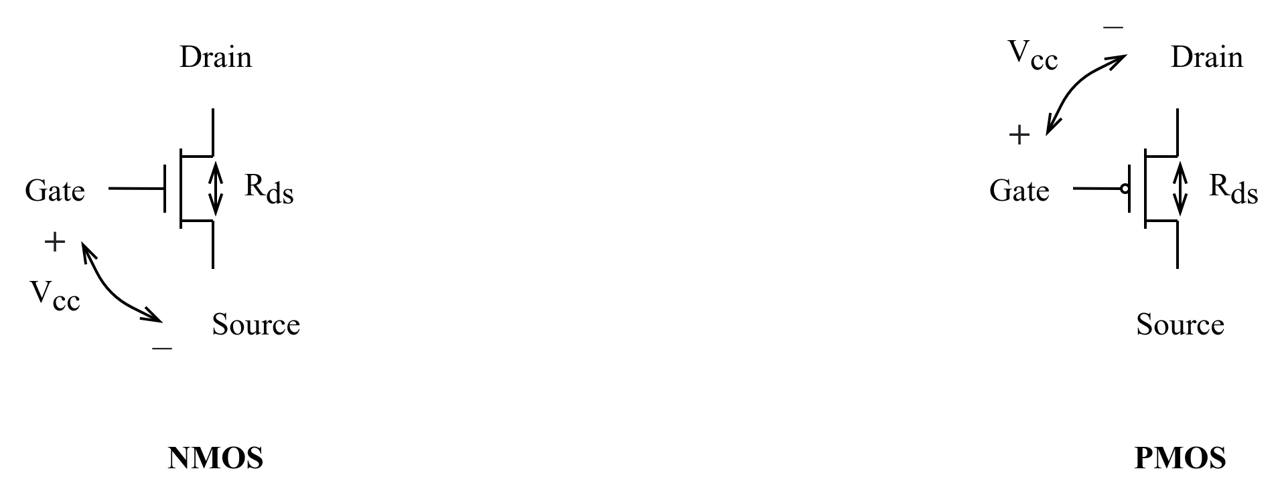
Integrated Circuit and Transistors
Integrated Circuit (IC)
  Transistor-Transistor Logic (TTL)
    Bipolar Junction Transistor (BJT)
  Complementary Metal-Oxide Semiconductor (CMOS)
    Field Effect Transistor (FET)
CMOS Transistors
  Gate, source, drain
  NMOS transistor / PMOS transistor
Notes:
双极结型晶体管（Bipolar Junction Transistor—BJT）又称为半导体三极管
①TTL是双极型电流控制器件，CMOS为单极性电压控制器件
②供电电压不一样，TTL常用5V供电，CMOS：5V、3.3V、2.4V、1.8V
③TTL抗干扰能力弱，噪声容限小，主要是因为CMOS逻辑电平范围宽，高电平阈值区间与低电平区间的距离大，抗干扰能力强；但CMOS器件输入阻抗大，容易捕捉干扰，噪声大。但CMOS输出阻抗低，在KΩ范围内；CMOS器件不用的输入引脚必须接地或者固定电平，（即注意静电防护）而TTL器件引脚悬空默认高电平。
④TTL功耗大，CMOS功耗低，静态功耗几乎没有，电平切换才有大电流。
⑤TTL器件工作速度快，传输延时5~10ns；cmos传输延时25~50ns。
Gate： 栅极
Source：源极
Drain：漏极
通过改变栅极和源极之间的电压差，可以控制两者间电阻R_{ds}的大小

Slide 29
Implementation of Logic Gates with Transistors
+V
+V
•
•
•
•
+V
•
X
.
Y
•
F
•
•
•
X
X
•
G = X +
Y
•
X
•
X
•
Y
•
Y
•
•
(a) NOR
(b) NAND
(c) NO
T
Transistor or tube implementations of logic functions are called logic gates or just gates
Transistor gate circuits can be modeled by switch circuits

Slide 30
Overview
Introduction
Binary logic and gates
Transistors
Some IC parameters
Boolean algebra
Logic functions
Simplification of logic functions
Additional Gates and Circuits

Slide 31
Some IC Parameters
V_{CC} (Power Supply Voltage)
Logic levels
  V_{IH}, V_{IL}, V_{OH}, V_{OL}
  Noise margin
Propagation delay
Transition time
Power dissipation
Fan-in and Fan-out
Gate Cost
Notes:
Logic level：逻辑电平，可以将连续变量映射到离散的二进制变量

Slide 32
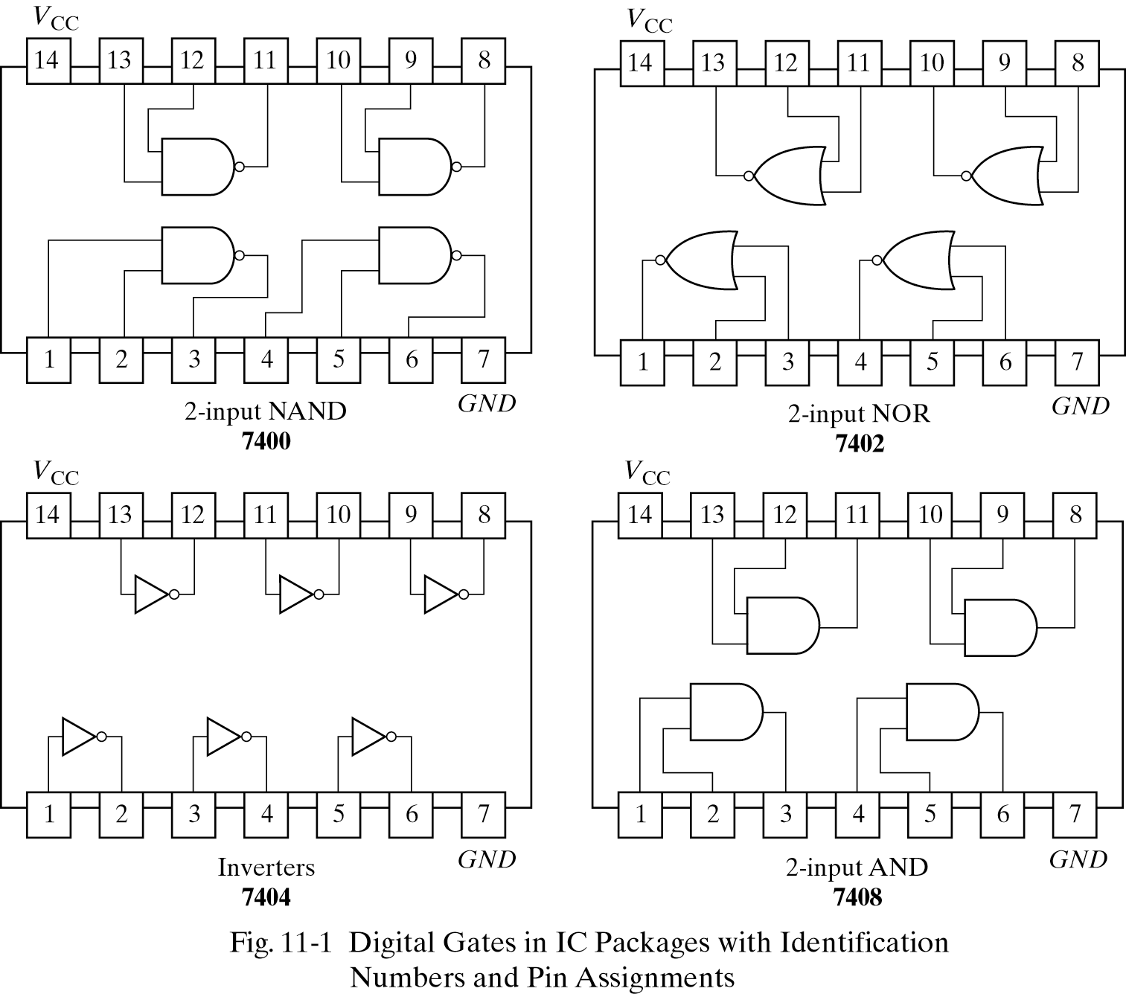
V_{CC} – Power Supply Voltage
Common across a logic family (e.g., 5V for all HC parts)
V_{CC} and GND commonly called “power supply rails”
  Sometimes V_{DD} and V_{SS} for CMOS devices
+5V

Slide 33
Logic Levels
Discrete voltages represent 1 and 0
For example:
  0 = ground (GND) or 0 volts
  1 = V_{CC} or 5 volts
What about 4.99 volts? Is that a 0 or a 1?
What about 3.2 volts?
Range of voltages for 1 and 0
Different ranges for inputs and outputs to allow for noise
Notes:
Logic level：逻辑电平，可以将连续变量映射到离散的二进制变量

Slide 34
What is Noise?
Anything that degrades the signal
  E.g., resistance, power supply noise, coupling to neighboring wires, etc.
Example: a gate (driver) outputs 5 V but, because of resistance in a long wire, receiver gets 4.5 V

Slide 35
Use Voltage Thresholds to Extract Discrete Values from Continuous Signals
0
1
0
Voltage
Time
Simplest version: 1-bit signal
  Either high range (1) or low range (0)
  With guard range between them
Not strongly affected by noise or low-quality circuit elements
  Can make circuits simple, small, and fast
Notes:
用电压阈值从连续信号中提取离散值
最简单版本：1位信号
或者是高位，或者是低位
在高位和低位之间有保护范围
不会收到噪音或者低质量的电路因素影响
可以使得电路简单、规模小、速度快

Slide 36
Noise Margins
NM_{H} = V_{OH} - V_{IH}
NM_{L} = V_{IL} - V_{OL}
Notes:
Noise margin: 噪声容限：噪音容限是指加到正常输入值上、且不会在电路的输出产生不可预料变化的最大外部噪音电压。
Common across a logic family
V_{IH}, V_{IL}, V_{OH}, V_{OL}
V_{IH} Minimum input voltage guaranteed to be recognized as H
V_{IL} Maximum input voltage guaranteed to be recognized as L
V_{OH} Minimum output voltage guaranteed produced for H
V_{OL} Maximum output voltage guaranteed produced for L
V_{OH} > V_{IH}
V_{OL} < V_{IL}

Slide 37
DC Transfer Characteristics
Ideal Buffer: Real Buffer:
NM_{H} = NM_{L} = VDD / 2
NM_{H}, NM_{L} < VDD / 2
Notes:
直流电压传输特性，考察门的模拟行为以理解数字抽象的局限性。
门的直流电压传输特性描述了当输入垫哑变化足够慢且保证输出能跟上输入的变化时，输出电压随输入电压变化的函数关系。
理想的在V_{DD}/2时产生跳变，如左图所示。
真实的在两个极端之间变化更缓慢，如右图所示。变化平滑，如何定义逻辑电平？
一种合理方法是，在传输特征曲线斜率dV(Y)/dV(A)为1的位置，这两个位置称为单位增益点（unity gain point），可最大化噪声容限。

Slide 38
Logic Family Examples
Logic Family | V_{DD} | V_{IL} | V_{IH} | V_{OL} | V_{OH}
TTL | 5 (4.75 - 5.25) | 0.8 | 2.0 | 0.4 | 2.4
CMOS | 5 (4.5 - 6) | 1.35 | 3.15 | 0.33 | 3.84
LVTTL | 3.3 (3 - 3.6) | 0.8 | 2.0 | 0.4 | 2.4
LVCMOS | 3.3 (3 - 3.6) | 0.9 | 1.8 | 0.36 | 2.7
Notes:
所以逻辑门可按照逻辑系列（logic family）区分，同一个系列的所有门都遵循同样的静态约束，彼此像积木一样组合在一起，使用相同的电源电压和逻辑电平。
TTL: Transistor-Transistor Logic
CMOS: Complementary Metal-Oxide-Semiconductor Logic
LVTTL: Low Voltage TTL
LvCMOS: Low Voltage CMOS
V_{OH} > V_{IH}
V_{OL} < V_{IL}
TTL驱动CMOS不兼容：TTL_VOH（2.4） < CMOS_VIH （3.15）
①TTL是双极型电流控制器件，CMOS为单极性电压控制器件
②供电电压不一样，TTL常用5V供电，CMOS：5V、3.3V、2.4V、1.8V
③TTL抗干扰能力弱，噪声容限小，主要是因为CMOS逻辑电平范围宽，高电平阈值区间与低电平区间的距离大，抗干扰能力强；但CMOS器件输入阻抗大，容易捕捉干扰，噪声大。但CMOS输出阻抗低，在KΩ范围内；CMOS器件不用的输入引脚必须接地或者固定电平，（即注意静电防护）而TTL器件引脚悬空默认高电平。
④TTL功耗大，CMOS功耗低，静态功耗几乎没有，电平切换才有大电流。
⑤TTL器件工作速度快，传输延时5~10ns；cmos传输延时25~50ns。

Slide 39
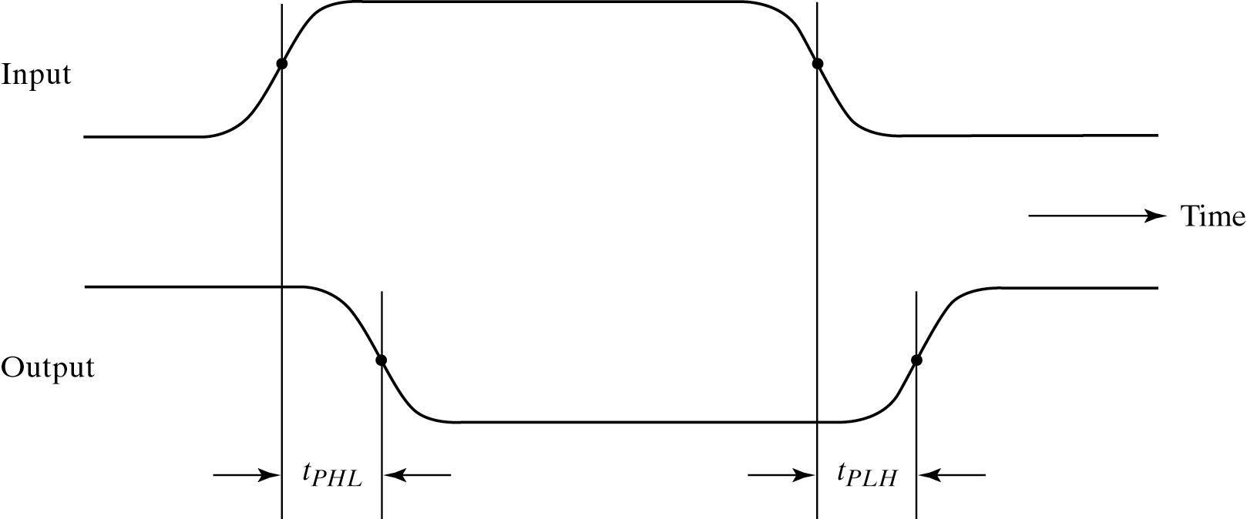
Propagation Delay (T_{pd}, T_{plh}, T_{phl})
Outputs don’t instantaneously reflect input changes
Propagation delay is a measure of this time
Delay from H to L can be different than from L to H
Notes:
输入信号发生变化到输出信号发生变化所需时间。
不同的信号通路（signal path，从一个输入信号到输出信号所经历的电气通路）传输延迟不同。
同一个信号通路，由于输出信号变化的方向不同，传输延迟也有可能不同。

Slide 40
Delay Models
Transport delay - a change of the output in response to a change on the inputs occurred after a fixed specified delay
Inertial delay - similar to transport delay, except that if input changes cause the output to changes twice in an interval less than the rejection time, then the first of the output changes does not occur. This models typical electronic circuit behavior, namely, rejects narrow “pulses” on the outputs
Notes:
抑制时间影响电路允许多小的脉冲。

Slide 41
Delay Model Example
A
B
A B:
No Delay
(ND)
a
b
c
d
e
Transport
Delay (TD)
Inertial
Delay (ID)
0
2
4
6
8
10
12
14
16
Time (ns)
Propagation Delay = 2.0 ns Rejection Time = 1.0 ns
Notes:
蓝色：传输延迟
黑色：惯性延迟
Inertial: /I’ne:tl/
如果没有惯性延迟，输出平移一个传输延迟时间

Slide 42
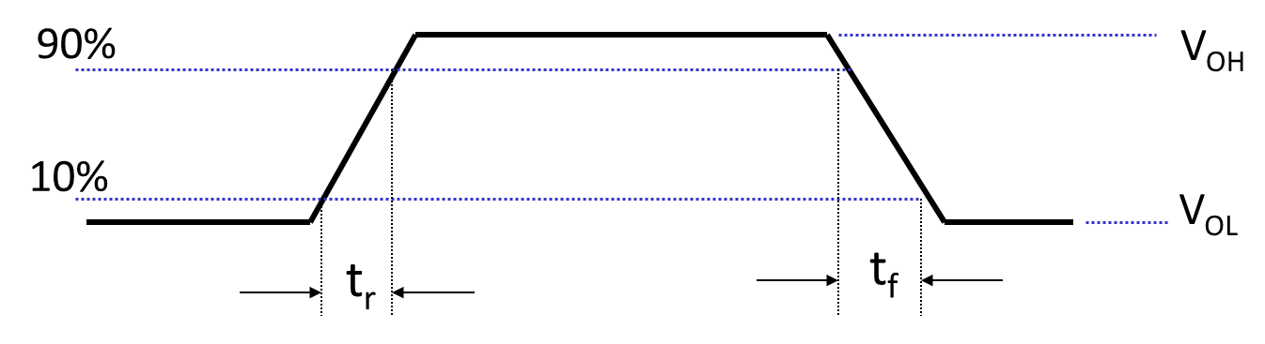
Transition Time (Rise & Fall)
Takes time for signal to reach its output voltage
Will be affected by capacitance, fan-out
Also known as slew rate
Typically measured from 10%/90% of V_{OL}/V_{OH} swing
Notes:
Transition time：转换时间，输出信号从一种状态转换到另一种状态所需要时间。
Rise time: 输出从低态到高态的转换时间
Fall time: 输出从高态到低态的转换时间
Capacitance: 电容
Fan-out: 扇出,可以从输出设备馈送输入信号的电路数量
Slew rate: 电压转换速率
V_{OL}/V_{OH} swing: 输出电压范围

Slide 43
Power Dissipation
Power “dissipation” and “consumption”
Static (“quiescent”) power dissipation
  When device outputs not changing
  Caused by the quiescent supply current, I_{DD} (also called the leakage current)：P_{S} = I_{DD} · V_{CC}
  Very low for CMOS
Dynamic power dissipation
Notes:
功率损耗
C_{PD}: 功耗电容值，输出状态转换引发的电路内部功耗
C_{L}: 负载电容值，输出从低态到高态，PMOS给负载电容充电，输出从高态到低态，NMOS让负载电容放电。
电容（Capacitance）亦称作“电容量”，是指在给定电位差下自由电荷的储藏量，指容纳电荷的能力。
一般来说，电荷在电场中会受力而移动，当导体之间有了介质，则阻碍了电荷移动而使得电荷累积在导体上，造成电荷的累积储存，储存的电荷量则称为电容。
F为输入信号高低状态的转换频率，即每秒高低状态转化次数除以2

Slide 44
Fan-in and Fan-out
Fan-in refers to the maximum number of input signals that feed the input equations of a logic cell.
  Fan-in is a term that defines the maximum number of digital inputs that a single logic gate can accept. Most transistor-transistor logic ( TTL) gates have one or two inputs, although some have more than two. A typical logic gate has a fan-in of 1 or 2.
Fan-out refers to the maximum number of output signals that are fed by the output equations of a logic cell.
  Fan Out is calculated from the amount of current available in the output of a gate and the amount of current needed in each input of the connecting gate. It is specified by manufacturer and is provided in the data sheet. Exceeding the specified maximum load may cause a malfunction because the circuit will not be able supply the demanded power.
Notes:
The fan-out is defined as the maximum number of inputs (load) that can be connected to the output of a gate without degrading the normal operation.

Slide 45
Fan-out
Fan-out can be defined in terms of a standard load
  Example: 1 standard load equals the load contributed by the input of 1 inverter.
  Transition time -the time required for the gate output to change from H to L, t_{HL}, or from L to H, t_{LH}
  The maximum fan-out that can be driven by a gate is the number of standard loads the gate can drive without exceeding its specified maximum transition time
Notes:
跃迁时间：输出有个渐变过程，梯形。与传输延迟不同。
门的速度越快，跃迁时间越短。
Example: 汽车加速，能拉多少货物

Slide 46
Fan-out and Delay
The fan-out loading of a gate’s output affects the gate’s propagation delay
Example:
  One equation for t_{pd} for a NAND gate with 4 inputs is:
    t_{pd} = 0.07 + 0.021 SL ns
  SL is the number of standard loads the gate is driving, i. e., its fan-out in standard loads
  For SL = 4.5, t_{pd} = 0.1645 ns
Notes:
不同工艺门的传输延迟不同：
TTL: 几个纳秒
Cmos: 上百个纳秒

Slide 47
Gate Cost
In an integrated circuit:
  The cost of a gate is proportional to the chip area occupied by the gate
  The gate area is roughly proportional to the number and size of the transistors and the amount of wiring connecting them
  Ignoring the wiring area, the gate area is roughly proportional to the gate input count
  So gate input count is a rough measure of gate cost
If the actual chip layout area occupied by the gate is known, it is a far more accurate measure
Notes:
The simpleast gate is NOT, NAND, NOR
对于基本的逻辑块，成本会列在说明里，normalized cost: 一般以非门成本作为标准1，其他门成本相当于几个非门，换算成数字

Slide 48
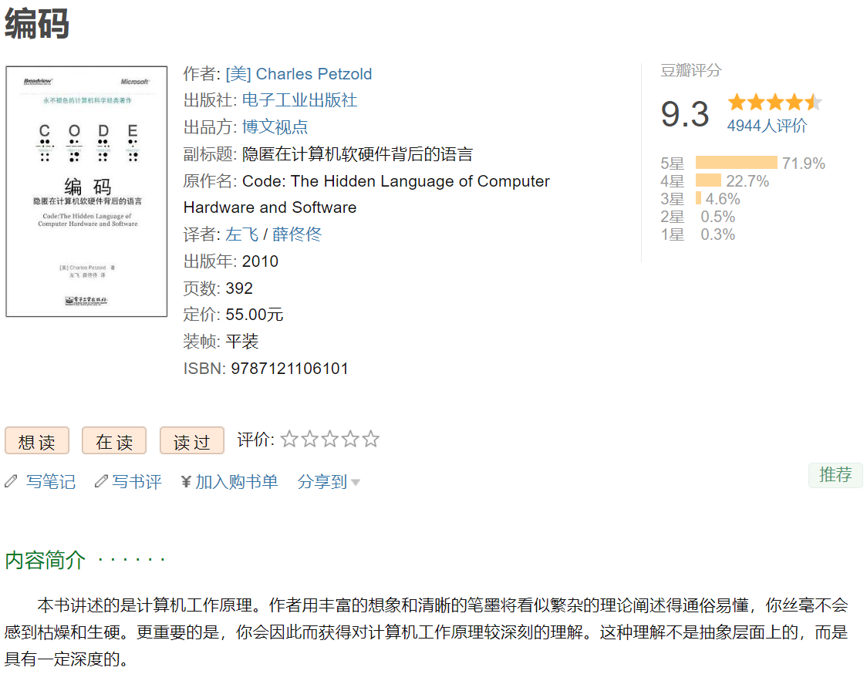
Further Reading (Optional)

Slide 49

Further Reading (Optional)

Slide 50
Overview
Introduction
Binary logic and gates
Transistors
Some IC parameters
Boolean algebra
Logic functions
Simplification of logic functions
Additional Gates and Circuits

Slide 51
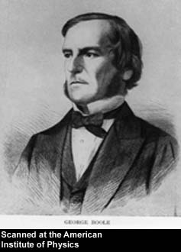
George Boole, 1815 - 1864
Born to working class parents
Taught himself mathematics and joined the faculty of Queen’s College in Ireland.
Wrote An Investigation of the Laws of Thought (1854)
Introduced binary variables
Introduced the three fundamental logic operations: AND, OR, and NOT.
Notes:
An Investigation of the Laws of Thought: 思维规律的研究

Slide 52
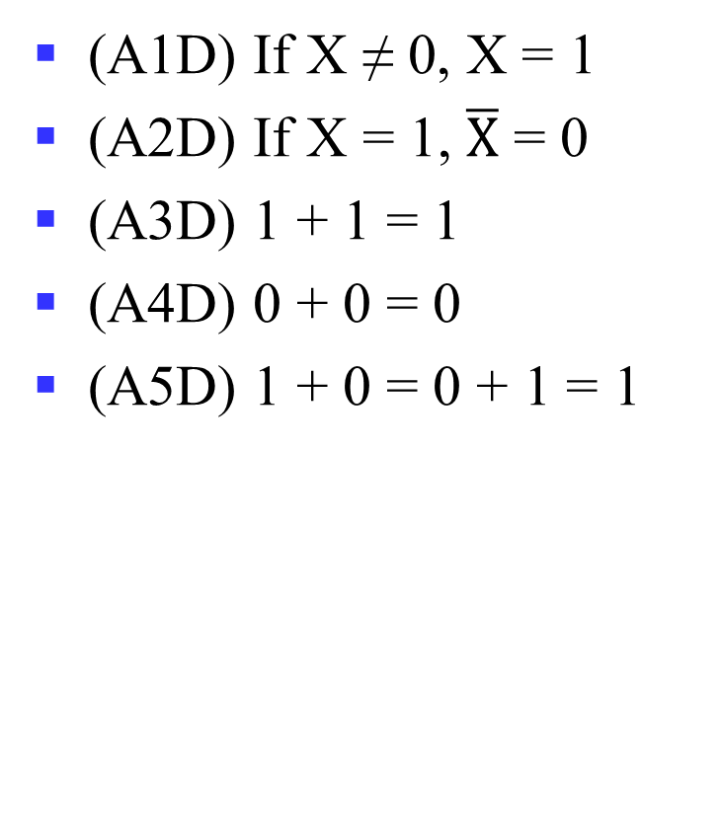
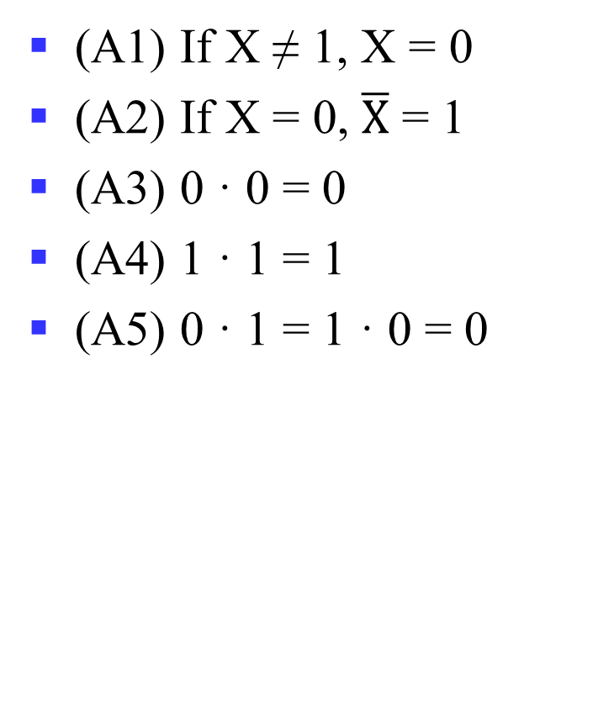
Axioms
(A1) If X ≠ 1, X = 0
(A2) If X = 0, $\overline{X}$ = 1
(A3) 0 · 0 = 0
(A4) 1 · 1 = 1
(A5) 0 · 1 = 1 · 0 = 0
(A1D) If X ≠ 0, X = 1
(A2D) If X = 1, $\overline{X}$ = 0
(A3D) 1 + 1 = 1
(A4D) 0 + 0 = 0
(A5D) 1 + 0 = 0 + 1 = 1

Slide 53
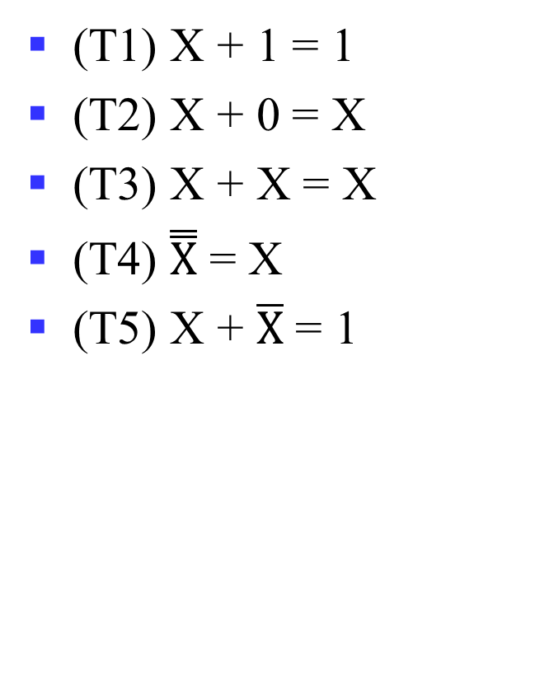
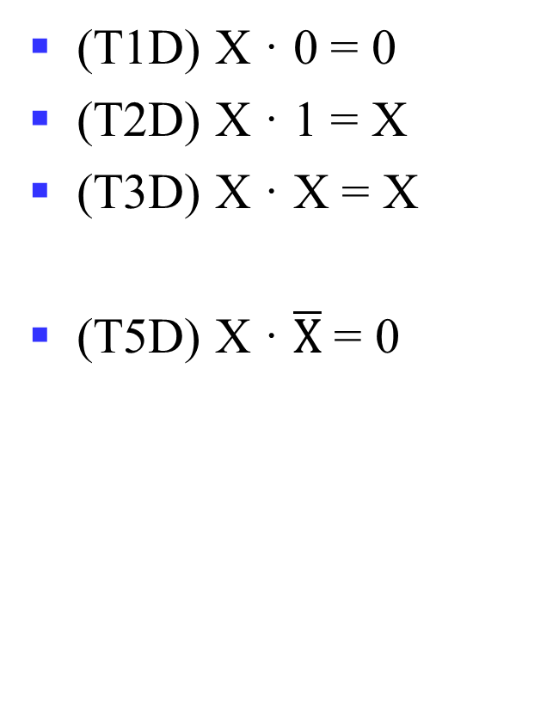
Theorems: Single Variable
(T1) X + 1 = 1
(T2) X + 0 = X
(T3) X + X = X
(T4) $\overset{̿}{X}$ = X
(T5) X + $\overline{X}$ = 1
(T1D) X · 0 = 0
(T2D) X · 1 = X
(T3D) X · X = X
(T5D) X · $\overline{X}$ = 0
Notes:
T1: Dominance 零律
T2: Identity 同一律
T3: Idempotent 幂等律
T4: Double negation 双重否定律
T5: Complement 互补律 （or T5: Excluded middle 排中律；T5D: Contradiction 矛盾律)

Slide 54
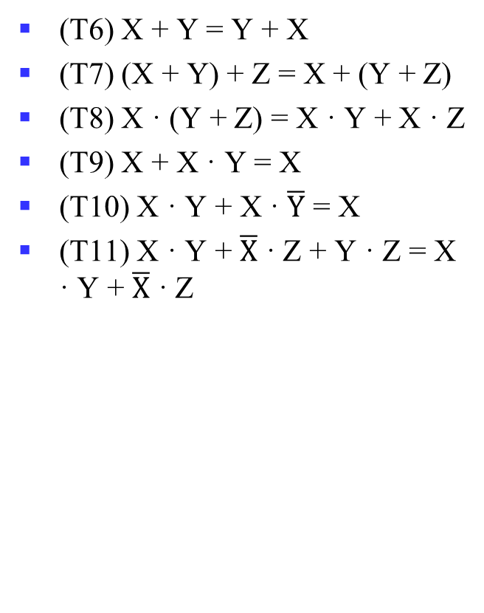
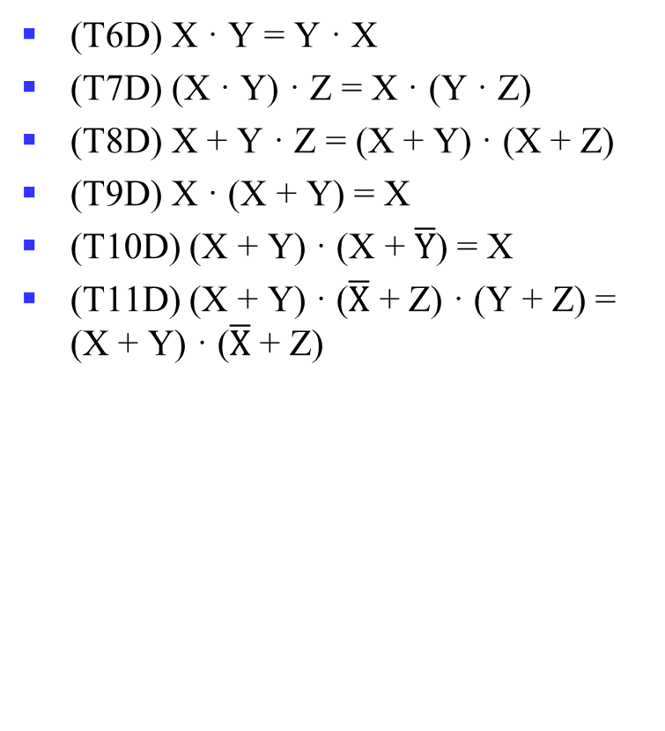
Theorems: 2-3 Variables
(T6) X + Y = Y + X
(T7) (X + Y) + Z = X + (Y + Z)
(T8) X · (Y + Z) = X · Y + X · Z
(T9) X + X · Y = X
(T10) X · Y + X · $\overline{Y}$ = X
(T11) X · Y + $\overline{X}$ · Z + Y · Z = X · Y + $\overline{X}$ · Z
(T6D) X · Y = Y · X
(T7D) (X · Y) · Z = X · (Y · Z)
(T8D) X + Y · Z = (X + Y) · (X + Z)
(T9D) X · (X + Y) = X
(T10D) (X + Y) · (X + $\overline{Y}$) = X
(T11D) (X + Y) · ($\overline{X}$ + Z) · (Y + Z) = (X + Y) · ($\overline{X}$ + Z)
Notes:
T6: 交换律 Commutative
T7: 结合律 Associative
T8: 分配律 Distributive
T9: 吸收律 Absorption
T10: 组合律 Adjacency
T11: 一致律 Consensus

Slide 55
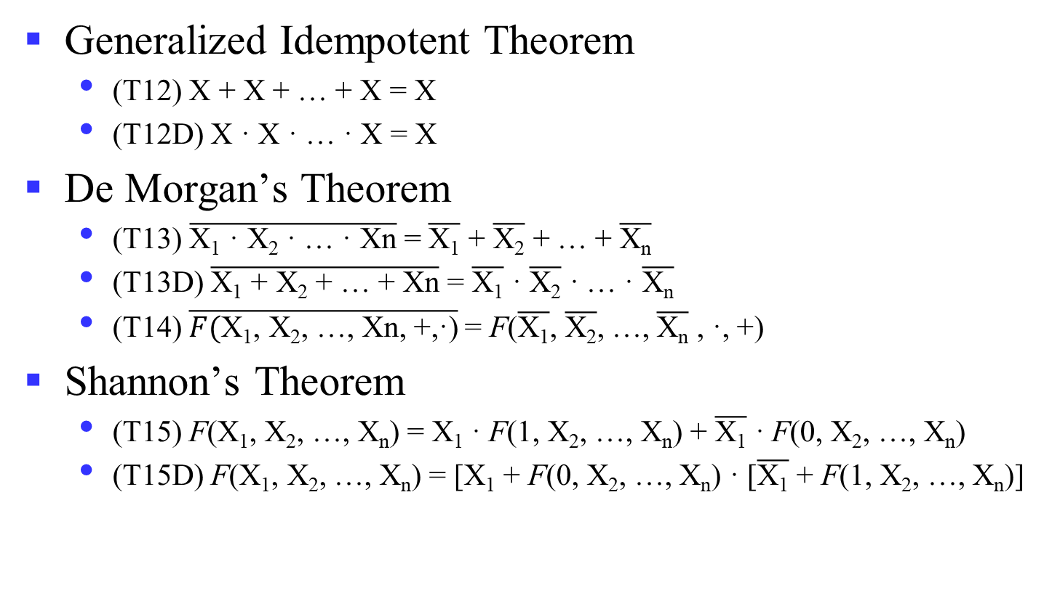
Theorems: n Variables
Generalized Idempotent Theorem
  (T12) X + X + … + X = X
  (T12D) X · X · … · X = X
De Morgan’s Theorem
  (T13) $\overline{\text{X}\text{1}\text{ · }\text{X}\text{2}\text{ · … · }\text{Xn}}$ = $\overline{\text{X}\text{1}}$ + $\overline{\text{X}\text{2}}$ + … + $\overline{\text{X}\text{n}}$
  (T13D) $\overline{\text{X}\text{1} \text{+} \text{X}\text{2} \text{+}\text{ … }\text{+} \text{Xn}}$ = $\overline{\text{X}\text{1}}$ $\text{·}$ $\overline{\text{X}\text{2}}$ $\text{·}$ … $\text{·}$ $\overline{\text{X}\text{n}}$
  (T14) $\overline{F(\text{X}\text{1}\text{,} \text{X}\text{2}\text{,}\text{ …}\text{,} \text{Xn}\text{, +,}\text{·}\text{)}}$= F($\overline{\text{X}\text{1}}\text{,}$ $\overline{\text{X}\text{2}}\text{,}$ …$\text{,}$ $\overline{\text{X}\text{n}}$ , $\text{·}$, +)
Shannon’s Theorem
  (T15) F(X₁, X₂, …, X_{n}) = X₁ · F(1, X₂, …, X_{n}) + $\overline{\text{X}\text{1}}$ · F(0, X₂, …, X_{n})
  (T15D) F(X₁, X₂, …, X_{n}) = [X₁ + F(0, X₂, …, X_{n}) · [$\overline{\text{X}\text{1}}$ + F(1, X₂, …, X_{n})]
Notes:
~(X+Y·Z) = ?
Wrong: (~X)·(~Y)+(~Z)?
XYZ=110
广义德摩根定理：对于一个逻辑表达式取反的结果，可以通过对每一项变量取反，并交换AND运算和OR运算而得到。
香农定理在组合逻辑函数的实现中有十分重要的应用，尤其是FPGA，利用LUT实现组合逻辑，但输入有限，通常为6变量函数。
如要实现7输入变量，则可利用香农定理，将两个6输入变量函数LUT的输出组合起来，可以实现任何7输入变量的逻辑函数。

Slide 56
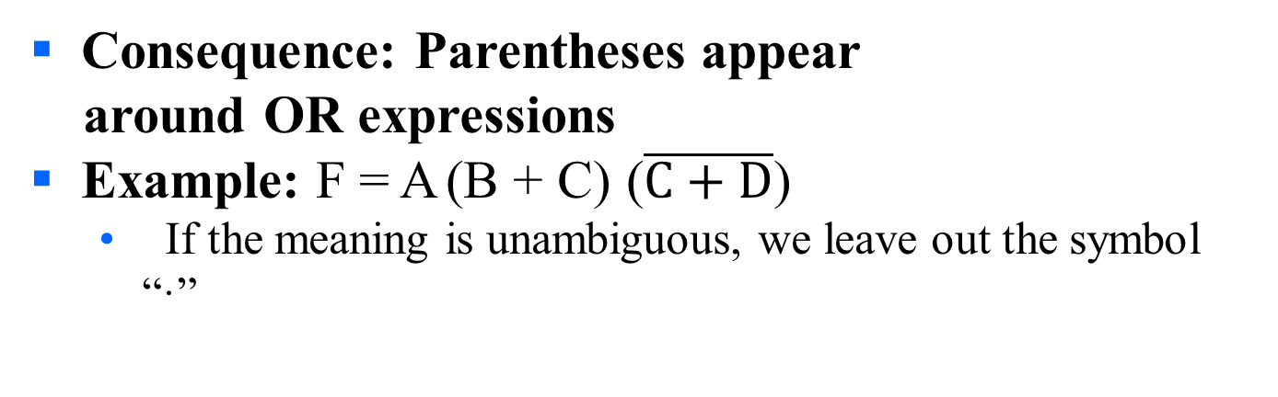
Boolean Operator Precedence
The order of evaluation in a Boolean
expression is:
1.
Parentheses
2.
NOT
3.
AND
4.
OR
Consequence: Parentheses appear
around OR expressions
Example: F = A (B + C) ($\overline{C+D}$)
  If the meaning is unambiguous, we leave out the symbol “·”

Slide 57
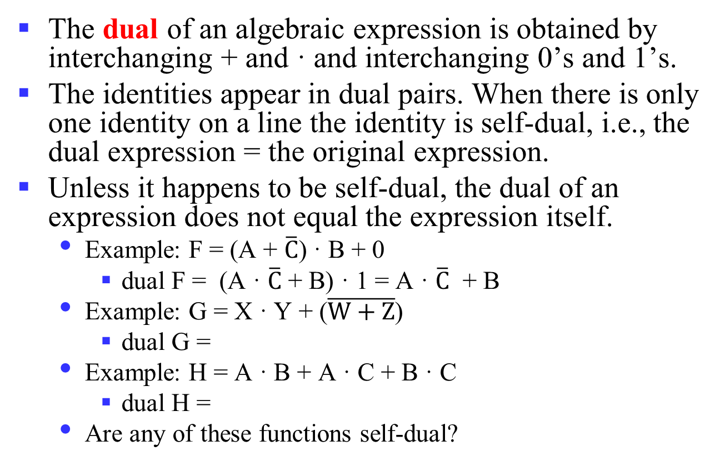
Some Properties of Identities & the Algebra
The dual of an algebraic expression is obtained by interchanging + and · and interchanging 0’s and 1’s.
The identities appear in dual pairs. When there is only one identity on a line the identity is self-dual, i.e., the dual expression = the original expression.
Unless it happens to be self-dual, the dual of an expression does not equal the expression itself.
  Example: F = (A + $\overline{C}$) · B + 0
    dual F = (A · $\overline{C}$ + B) · 1 = A · $\overline{C}$ + B
  Example: G = X · Y + ($\overline{W+Z}$)
    dual G =
  Example: H = A · B + A · C + B · C
    dual H =
  Are any of these functions self-dual?
Notes:
Dual G = ((X+Y) · (W · Z)') = ((X+Y) ·(W' + Z')
Dual H = (A + B)(A + C)(B + C). Using the Boolean identities,
= (A +BC) (B+C) = AB + AC + BC.
So H is self-dual.

Slide 58
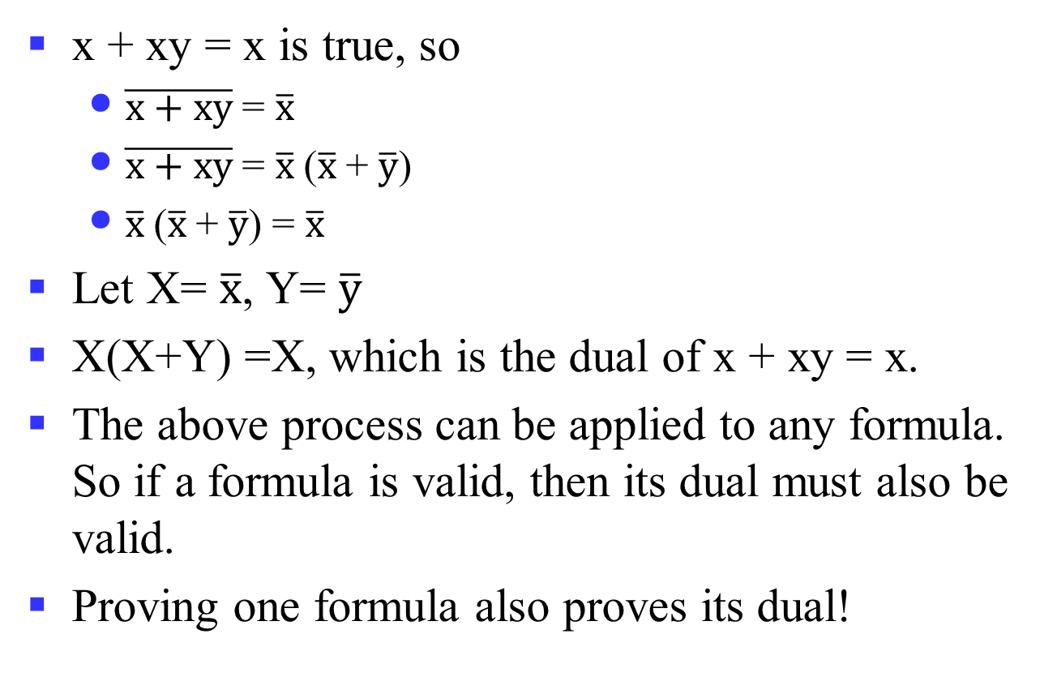
Power of Duality
x + xy = x is true, so
  $\overline{x+xy}$= $\overline{x}$
  $\overline{x+xy}$= $\overline{x}$($\overline{x}$+ $\overline{y}$)
  $\overline{x}$($\overline{x}$+ $\overline{y}$) = $\overline{x}$
Let X= $\overline{x}$, Y= $\overline{y}$
X(X+Y) =X, which is the dual of x + xy = x.
The above process can be applied to any formula. So if a formula is valid, then its dual must also be valid.
Proving one formula also proves its dual!
Notes:
Recall T9 and T9D
(T9) X + X · Y = X
(T9D) X · (X + Y) = X
对偶性原理：若两个逻辑表达式相等，那么它们的对偶式也相等。

Slide 59
Example 1: Boolean Algebraic Proof
A + A·B = A (Absorption Theorem)
Proof Steps Justification (identity or theorem)
A + A·B
= A · 1 + A · B X = X · 1
= A · ( 1 + B) X · Y + X · Z = X ·(Y + Z)(Distributive Law)
= A · 1 1 + X = 1
= A X · 1 = X
Our primary reason for doing proofs is to learn:
  Careful and efficient use of the identities and theorems of Boolean algebra, and
  How to choose the appropriate identity or theorem to apply to make forward progress, irrespective of the application.

Slide 60
Example 2: Boolean Algebraic Proofs
AB + AC + BC = AB + AC (Consensus Theorem)
Proof Steps
AB + AC + BC
= ?
Notes:
Justification 1: 1 . X = X
Justification 2: X + X’ = 1
= AB + A’C + ABC + A’BC X(Y + Z) = XY + XZ (Distributive Law)
= AB + ABC + A’C + A’BC X + Y = Y + X (Commutative Law)
= AB . 1 + ABC + A’C . 1 + A’C . B X . 1 = X, X . Y = Y . X (Commutative Law)
= AB (1 + C) + A’C (1 + B) X(Y + Z) = XY +XZ (Distributive Law)
= AB . 1 + A’C . 1 = AB + A’C X . 1 = X

Slide 61
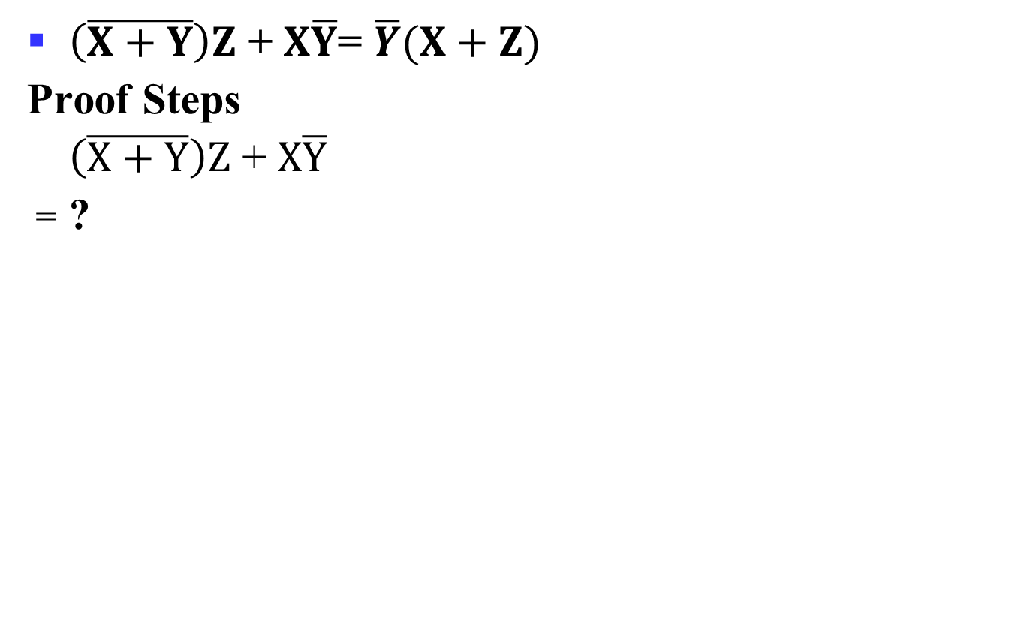
Example 3: Boolean Algebraic Proofs
$\left(\overline{X+Y}\right)Z$ + $X\overline{Y}$= $\overline{Y}(X+Z)$
Proof Steps
$\left(\overline{X+Y}\right)Z$ + $X\overline{Y}$
= ?
Notes:
= X’ Y’ Z + X Y’ (A + B)’ = A’ . B’ (DeMorgan’s Law)
= Y’ X’ Z + Y’ X A . B = B . A (Commutative Law)
= Y’ (X’ Z + X) A(B + C) = AB + AC (Distributive Law)
= Y’ (X’ + X)(Z + X) A + BC = (A + B)(A + C) (Distributive Law)
= Y’ . 1 . (Z + X) A + A’ = 1
= Y’ (X + Z) 1 . A = A, A + B = B + A (Commutative Law)

Slide 62
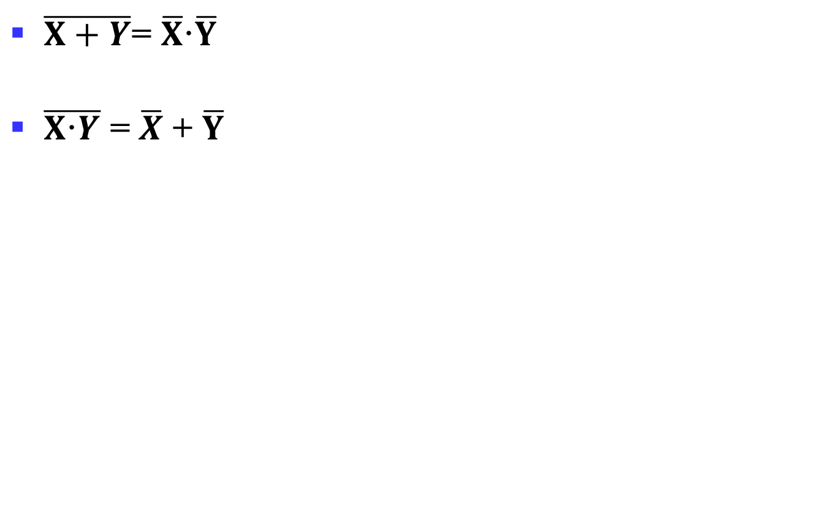
Proof of DeMorgan’s Laws
$\overline{X+Y}$= $\overline{X}\text{·}\overline{Y}$
$\overline{X\text{·}Y}$ = $\overline{X}$ + $\overline{Y}$
Notes:
It is important that we do not USE DeMorgan’s Laws in doing this proof.
This requires a different proof method. We will show that, x’ . y’, satisfies
the definition of the complement of (x + y), defined as (x + y)’ by
DeMorgan’s Law.
To show this we need to show that A + A’ = 1 and A.A’ = 0 with
A = x + y and A’ = x’. y’. This proves that x’. y’ = (x + y)’.
Part 1: Show x + y + x’. y’ = 1.
x + y + x’. y’
= (x + y + x’) (x + y + y’) X + YZ = (X + Y)(X + Z) (Distributive Law)
= (x + x’ + y) (x + y + y’) X + Y = Y + X (Commutative Law)
= (1 + y)(x + 1) X + X’ = 1
= 1 . 1 1 + X = 1
= 1 1 . X = 1
Part 2: Show (x + y) . x’. y’ = 0.
(x + y) . x’. y’
= (x . x’. y’ + y . x’. y’) X (Y + Z) = XY + XZ (Distributive Law)
= (x . x’. y’ + y . y’ . x’) XY = YX (Commutative Law)
= (0 . y’ + 0 . x’) X . X’ = 0
= (0 + 0) 0 . X = 0
= 0 X + 0 = X (With X = 0)
Based on the above two parts, x’y’ = (x + y)’
The second DeMorgans’ law is proved by duality. Note that DeMorgan’s
Law, given as an identity is not an axiom in the sense that it can be
proved using the other identities.

Slide 63
Overview
Introduction
Binary logic and gates
Digital abstraction
Transistors
Boolean algebra
Logic functions
Simplification of logic functions
Additional Gates and Circuits

Slide 64
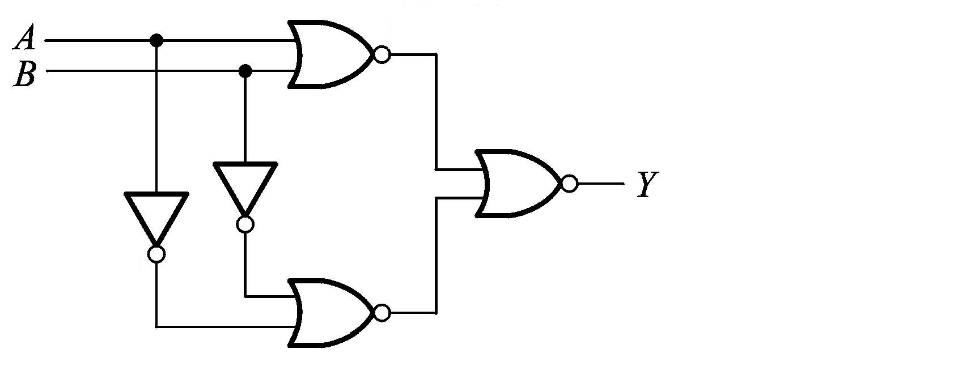
Representation of Logic Functions
Logic Functions
  F(X₁, X₂, …, X_{n})
What is the logic function?
逻辑函数是反映输入变量和输出变量之间关系的逻辑关系表达式。
Notes:
逻辑函数是反映输入变量和输出变量之间关系的逻辑关系表达式。
每一组输入组合都有一个确定的输入值，F(x,y)有4个输入，则输出有16种组合，那么就对应着16个不同的逻辑函数F_{i}(x,y)
F(A, B) = Y = ((A + B)’ + (A’ + B’) ’)’

Slide 65
Truth Table vs. Waveforms
Representations of Logic Functions
  Truth Table
  Waveforms
X₁ | … | X_{n} | F
0 | … | 1 | 0
0 | … | 0 | 1
1 | … | 1 | 1
… | … | … | …
0 | … | 0 | 1
X₁
X₂
…
X_{n}
F
…
…
…
…
…
Notes:
逻辑函数输入变量的变化和输出的变化之间存在时间上的关联，因此可以用波形图来显示函数输出变量对于输入变量的变化所产生的响应。
理想状态下，波形图可以忽视数字电路的时间延迟。
一个完整的波形图需要列出所有的输入组合和对应的输出值。

Slide 66
Truth Tables
Truth table: a unique representation of a Boolean function
If two functions have identical truth tables, the functions are equivalent (and vice-versa).
Truth tables can be used to prove equality theorems.
However, the size of a truth table grows exponentially with the number of variables involved, hence unwieldy. This motivates the use of Boolean Algebra.

Slide 67
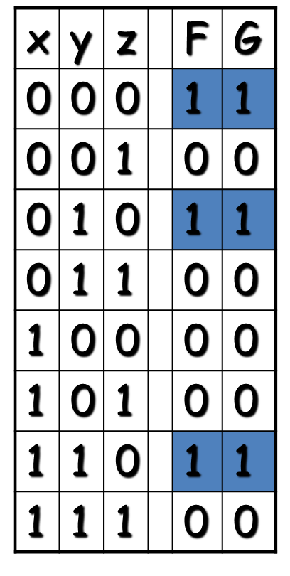
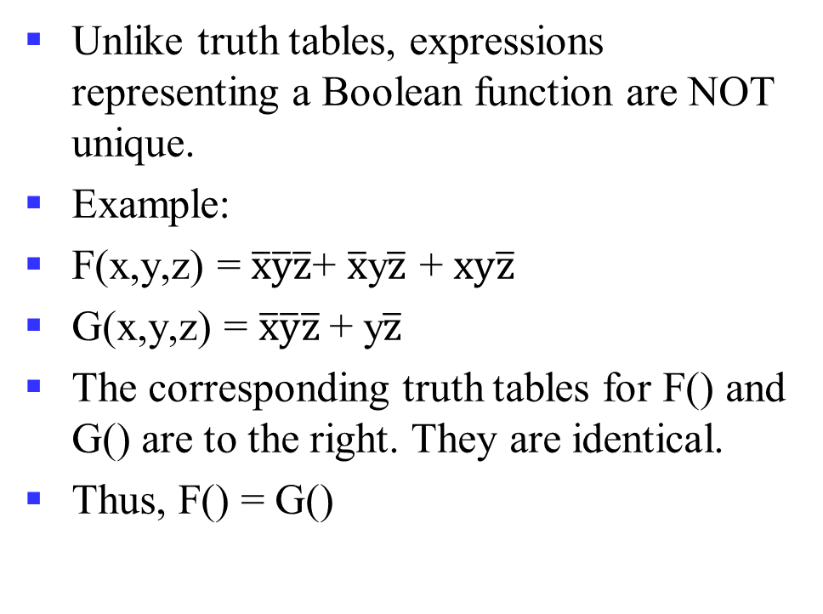
Boolean expressions-NOT unique
Unlike truth tables, expressions representing a Boolean function are NOT unique.
Example:
F(x,y,z) = $\overline{x}\overline{y}\overline{z}$+ $\overline{x}$y$\overline{z}$ + $xy\overline{z}$
G(x,y,z) = $\overline{x}\overline{y}\overline{z}$+ y$\overline{z}$
The corresponding truth tables for F() and G() are to the right. They are identical.
Thus, F() = G()

Slide 68
Complement of a Function
The complement of a function is derived by interchanging (• and +), and (1 and 0), and complementing each variable.
Otherwise, interchange 1s to 0s in the truth table column showing F.
The complement of a function IS NOT THE SAME as the dual of a function.

Slide 69
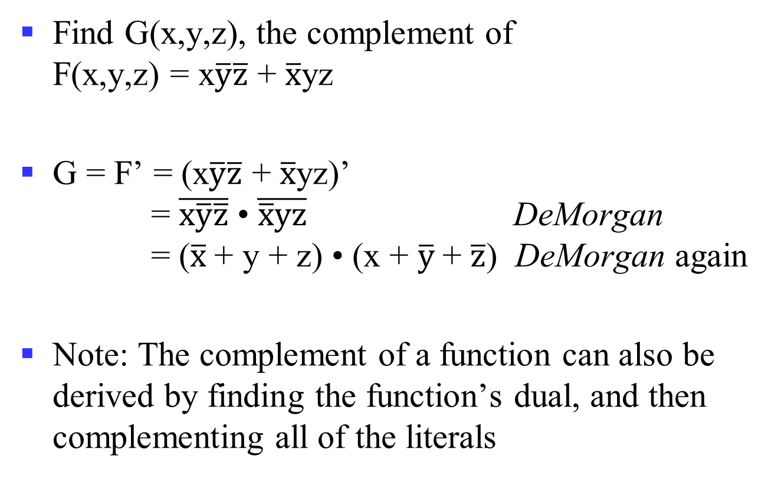
Complementation: An Example
Find G(x,y,z), the complement of
F(x,y,z) = x$\overline{y}\overline{z}$ + $\overline{x}$yz
G = F’ = (x$\overline{y}\overline{z}$ + $\overline{x}$yz)’
= $\overline{x\overline{y}\overline{z}}$ • $\overline{\overline{x}yz}$ DeMorgan
= ($\overline{x}$+ y + z) • (x + $\overline{y}$+ $\overline{z}$) DeMorgan again
Note: The complement of a function can also be derived by finding the function’s dual, and then complementing all of the literals
Notes:
Complement G = (a + bc)d + e
G' = ((a (b' + c'))+ d ) e' = (a (b' + c') + d) e'

Slide 70
Canonical and Standard Forms
We need to consider formal techniques for the simplification of Boolean functions.
  Identical functions will have exactly the same canonical form.
  Minterms and Maxterms
  Sum-of-Minterms and Product-of- Maxterms
  Product and Sum terms
  Sum-of-Products (SOP) and Product-of-Sums (POS)
Notes:
Canonical and Standard
规范型和标准型

Slide 71
Definitions
Literal: A variable or its complement
Product term: literals connected by •
Sum term: literals connected by +
Minterm: a product term in which all the variables appear exactly once, either complemented or uncomplemented
Maxterm: a sum term in which all the variables appear exactly once, either complemented or uncomplemented
Notes:
Literal: 字面量/文字，一个变量或者反变量
Product term: 乘积项
Sum term: 求和项
Minterm: 最小项，每个逻辑变量出现且仅出现一次的乘积项
Maxterm: 最大项，每个逻辑变量出现且仅出现一次的求和项

Slide 72
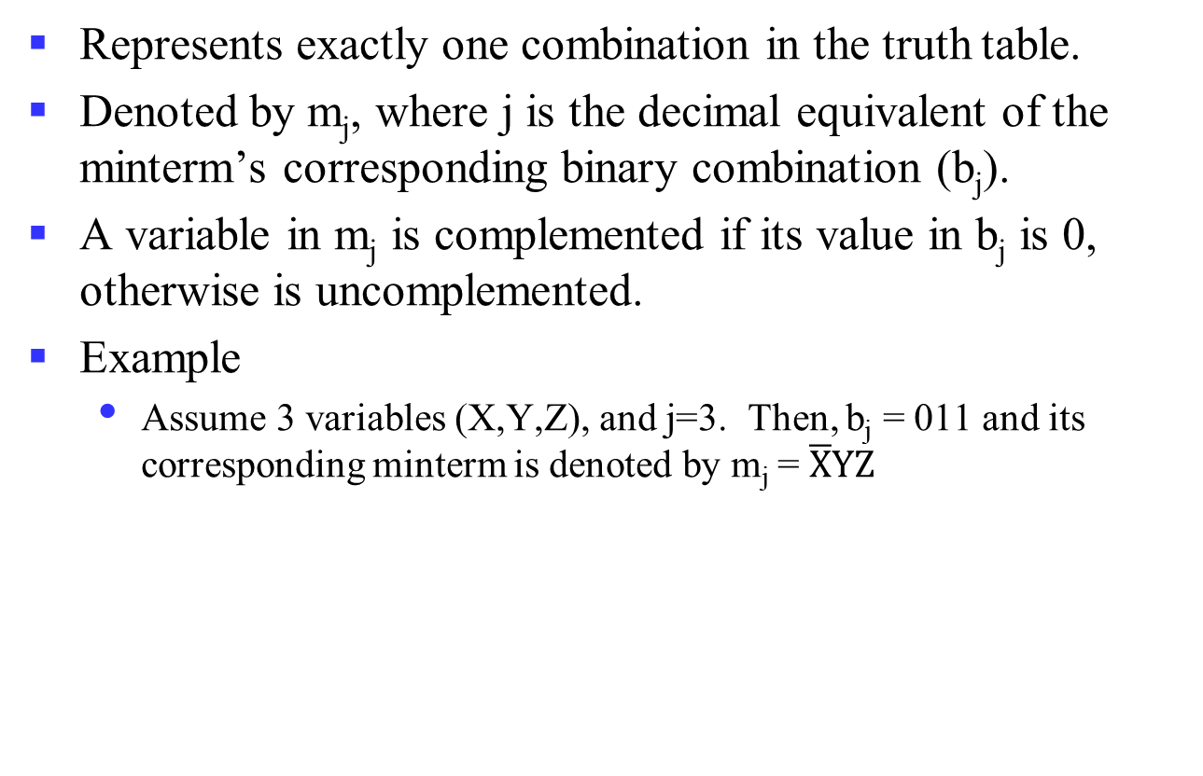
Minterm
Represents exactly one combination in the truth table.
Denoted by m_{j}, where j is the decimal equivalent of the minterm’s corresponding binary combination (b_{j}).
A variable in m_{j} is complemented if its value in b_{j} is 0, otherwise is uncomplemented.
Example
  Assume 3 variables (X,Y,Z), and j=3. Then, b_{j} = 011 and its corresponding minterm is denoted by m_{j} = $\overline{X}YZ$

Slide 73

Maxterm
Represents exactly one combination in the truth table.
Denoted by M_{j}, where j is the decimal equivalent of the maxterm’s corresponding binary combination (b_{j}).
A variable in M_{j} is complemented if its value in b_{j} is 1, otherwise is uncomplemented.
Example
  Assume 3 variables (X,Y,Z), and j=3. Then, b_{j} = 011 and its corresponding maxterm is denoted by M_{j} = X+ $\overline{Y}$+ $\overline{Z}$

Slide 74
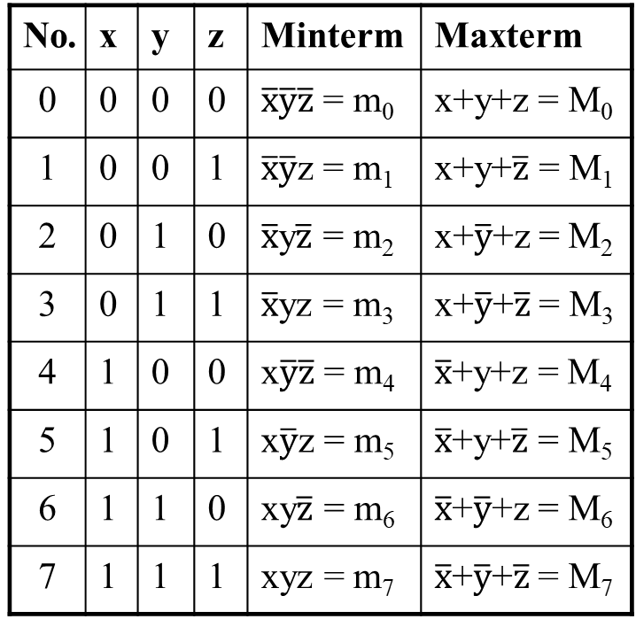
Truth Table notation for Minterms and Maxterms
Minterms and Maxterms are easy to denote using a truth table.
Example:
Assume 3 variables x,y,z
(order is fixed)
No. | x | y | z | Minterm | Maxterm
0 | 0 | 0 | 0 | $\overline{x}\overline{y}\overline{z}$ = m₀ | x+y+z = M₀
1 | 0 | 0 | 1 | $\overline{x}\overline{y}$z = m₁ | x+y+$\overline{z}$ = M₁
2 | 0 | 1 | 0 | $\overline{x}$y$\overline{z}$ = m₂ | x+$\overline{y}$+z = M₂
3 | 0 | 1 | 1 | $\overline{x}$yz = m₃ | x+$\overline{y}$+$\overline{z}$ = M₃
4 | 1 | 0 | 0 | x$\overline{y}\overline{z}$ = m₄ | $\overline{x}$+y+z = M₄
5 | 1 | 0 | 1 | x$\overline{y}$z = m₅ | $\overline{x}$+y+$\overline{z}$ = M₅
6 | 1 | 1 | 0 | xy$\overline{z}$ = m₆ | $\overline{x}$+$\overline{y}$+z = M₆
7 | 1 | 1 | 1 | xyz = m₇ | $\overline{x}$+$\overline{y}$+$\overline{z}$ = M₇

Slide 75
Canonical Forms (Unique)
Any Boolean function F() can be expressed as a unique sum of minterms and a unique product of maxterms (under a fixed variable ordering).
In other words, every function F() has two canonical forms:
  Canonical Sum-Of-Products (sum of minterms)
  Canonical Product-Of-Sums (product of maxterms)

Slide 76
Canonical Forms (cont.)
Canonical Sum-Of-Products:
The minterms included are those m_{j} such that F() = 1 in row j of the truth table for F().
Canonical Product-Of-Sums:
The maxterms included are those M_{j} such that F() = 0 in row j of the truth table for F().
F(X1, X2,…, Xn) = Σ (minterms for 1s of the function)
F(X1, X2,…, Xn) = Π (maxterms for 0s of the function)

Slide 77
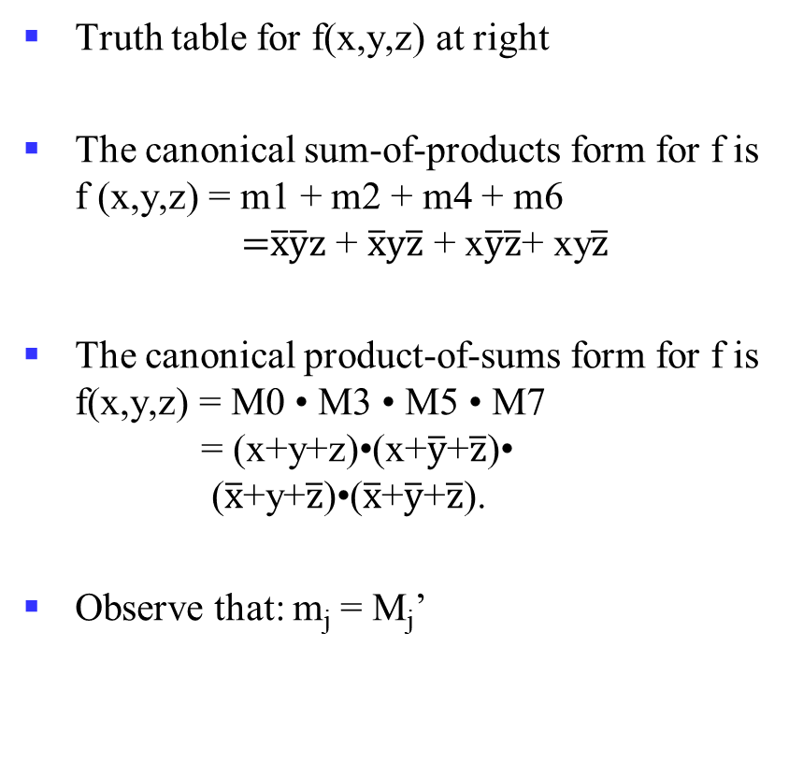
An Example
Truth table for f(x,y,z) at right
The canonical sum-of-products form for f is
f (x,y,z) = m1 + m2 + m4 + m6
=$\overline{x}\overline{y}z$ + $\overline{x}y\overline{z}$ + x$\overline{y}\overline{z}$+ xy$\overline{z}$
The canonical product-of-sums form for f is
f(x,y,z) = M0 • M3 • M5 • M7
= (x+y+z)•(x+$\overline{y}$+$\overline{z}$)• ($\overline{x}$+y+$\overline{z}$)•($\overline{x}$+$\overline{y}$+$\overline{z}$).
Observe that: m_{j} = M_{j}’
x | y | z |  | f
0 | 0 | 0 |  | 0
0 | 0 | 1 |  | 1
0 | 1 | 0 |  | 1
0 | 1 | 1 |  | 0
1 | 0 | 0 |  | 1
1 | 0 | 1 |  | 0
1 | 1 | 0 |  | 1
1 | 1 | 1 |  | 0

Slide 78
Shorthand: ∑ and ∏
f(x,y,z) = ∑ m(1,2,4,6), where ∑ indicates that this is a sum-of-products form, and m(1,2,4,6) indicates that the minterms to be included are m1, m2, m4, and m6.
f(x,y,z) = ∏ M(0,3,5,7), where ∏ indicates that this is a product-of-sums form, and M(0,3,5,7) indicates that the maxterms to be included are M0, M3, M5, and M7.
Since m_{j} = M_{j}’ for any j,
∑ m(1,2,4,6) = ∏ M(0,3,5,7) = f(x,y,z)
Notes:
∑ m(1,2,4,6) 最小项列表
∏ M(0,3,5,7) 最大项列表
一个n变量逻辑函数的最小项列表编号集合约最大项列表编号集合的并集为n位编号全集{0, 1, …, 2^{n}-1}，两者交集为空，是互补关系。
所以可以互相转换，只需对编码集合求补即可：Replace ∑ with ∏ (or vice versa) and replace those j’s that appeared in the original form with those that do not.

Slide 79
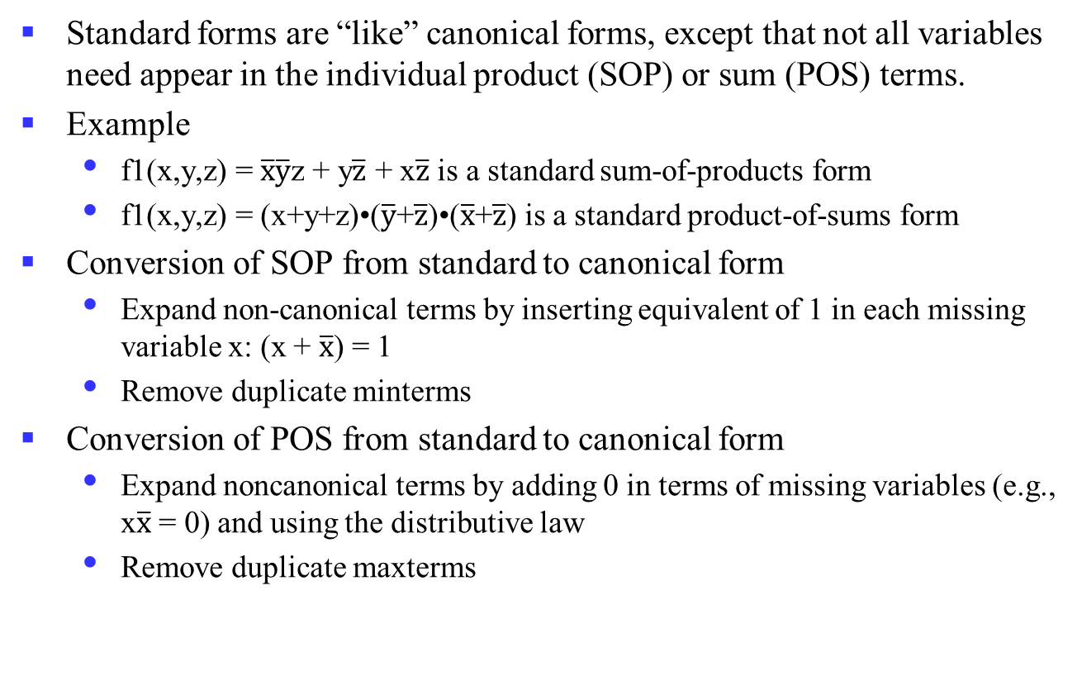
Standard Forms (NOT Unique)
Standard forms are “like” canonical forms, except that not all variables need appear in the individual product (SOP) or sum (POS) terms.
Example
  f1(x,y,z) = $\overline{x}\overline{y}$z + y$\overline{z}$ + x$\overline{z}$ is a standard sum-of-products form
  f1(x,y,z) = (x+y+z)•($\overline{y}$+$\overline{z}$)•($\overline{x}$+$\overline{z}$) is a standard product-of-sums form
Conversion of SOP from standard to canonical form
  Expand non-canonical terms by inserting equivalent of 1 in each missing variable x: (x + $\overline{x}$) = 1
  Remove duplicate minterms
Conversion of POS from standard to canonical form
  Expand noncanonical terms by adding 0 in terms of missing variables (e.g., x$\overline{x}$ = 0) and using the distributive law
  Remove duplicate maxterms
Notes:
SOP （standard->canonical）
f₁(x,y,z) = x’y’z + yz’ + xz’
= x’y’z + (x+x’)yz’ + x(y+y’)z’
= x’y’z + xyz’ + x’yz’ + xyz’ + xy’z’
= x’y’z + xyz’ + x’yz + xy’z’
POS （standard->canonical）
f₁(x,y,z) = (x+y+z)•(y’+z’)•(x’+z’)
= (x+y+z)•(xx’+y’+z’)•(x’+yy’+z’)
= (x+y+z)•(x+y’+z’)•(x’+y’+z’)•(x’+y+z’)•(x’+y’+z’)
= (x+y+z)•(x+y’+z’)•(x’+y’+z’)•(x’+y+z’)

Slide 80
Overview
Introduction
Binary logic and gates
Transistors
Some IC parameters
Boolean algebra
Logic functions
Simplification of logic functions
Additional Gates and Circuits

Slide 81
Simplification of Logic Functions
About Cost Criterion
  See the optional material for more details
Algebra Method
  Use the theorems
Karnaugh Map
  Graphical representations

Slide 82
Circuit Optimization
Goal: To obtain the simplest implementation for a given function
  Optimization is a more formal approach to simplification that is performed using a specific procedure or algorithm
Optimization requires a cost criterion to measure the simplicity of a circuit
Distinct cost criteria we will use:
  Literal cost (L)
  Gate input cost (G)
  Gate input cost with NOTs (GN)

Slide 83
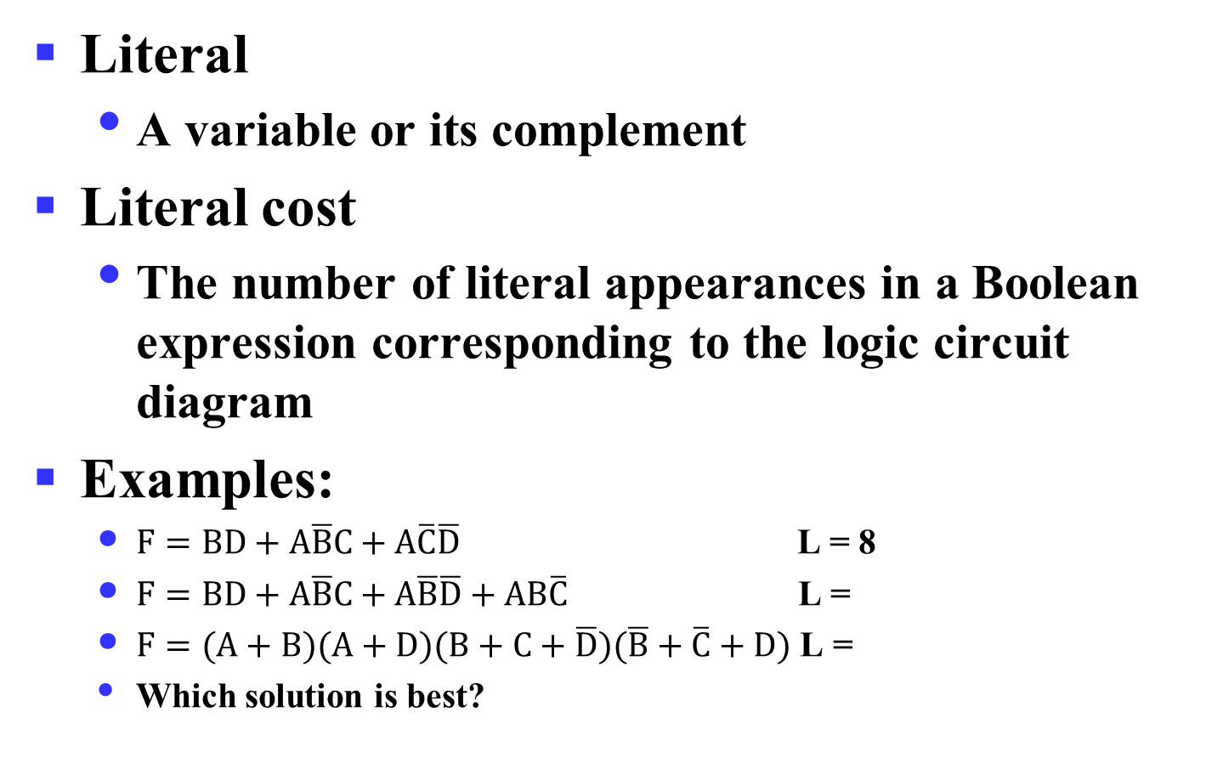
Literal Cost
Literal
  A variable or its complement
Literal cost
  The number of literal appearances in a Boolean expression corresponding to the logic circuit diagram
Examples:
  $F=BD+A\overline{B}C+A\overline{C}\overline{D}$ L = 8
  $F=BD+A\overline{B}C+A\overline{B}\overline{D}+AB\overline{C}$ L =
  $F=(A+B)(A+D)(B+C+\overline{D})(\overline{B}+\overline{C}+D)$ L =
  Which solution is best?
Notes:
2nd Literal Cost = 11
3rd Literal Cost = 10
The first solution is best

Slide 84
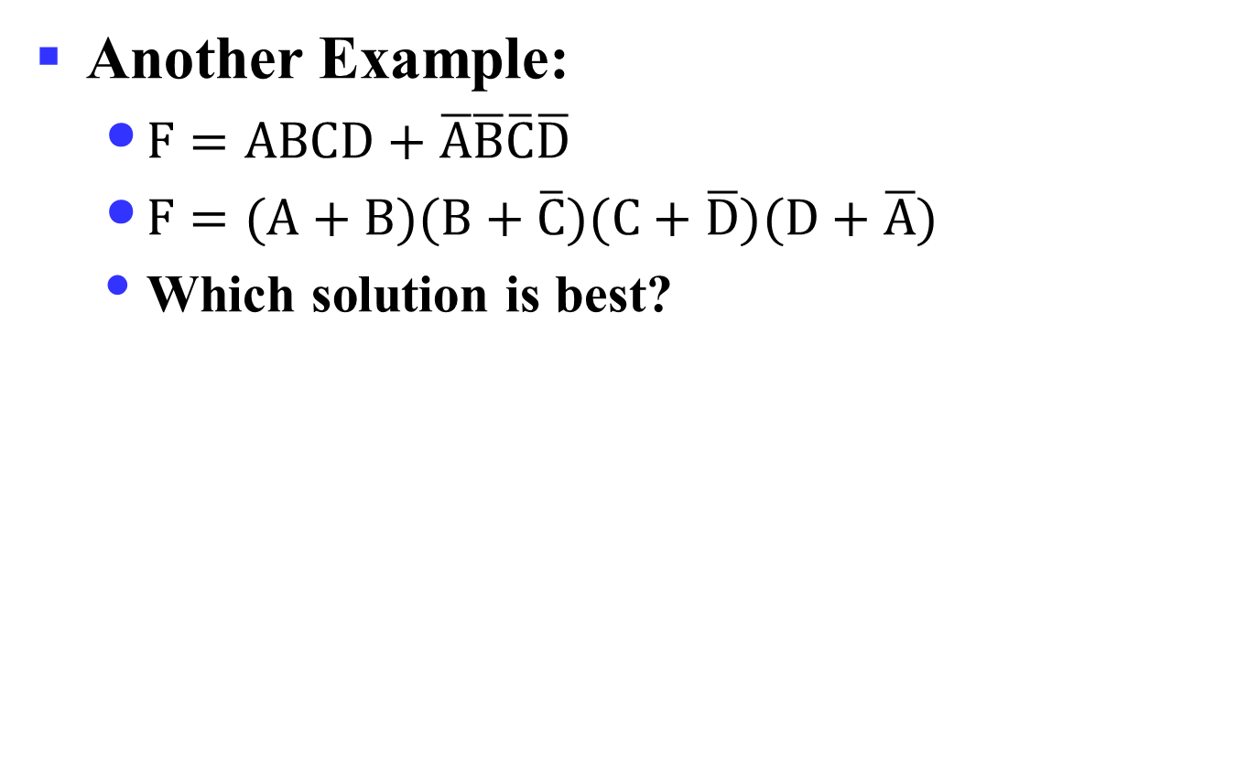
Literal Cost
Another Example:
  $F=ABCD+\overline{A}\overline{B}\overline{C}\overline{D}$
  $F=(A+B)(B+\overline{C})(C+\overline{D})(D+\overline{A})$
  Which solution is best?
Notes:
2个函数项 vs. 4个函数项

Slide 85
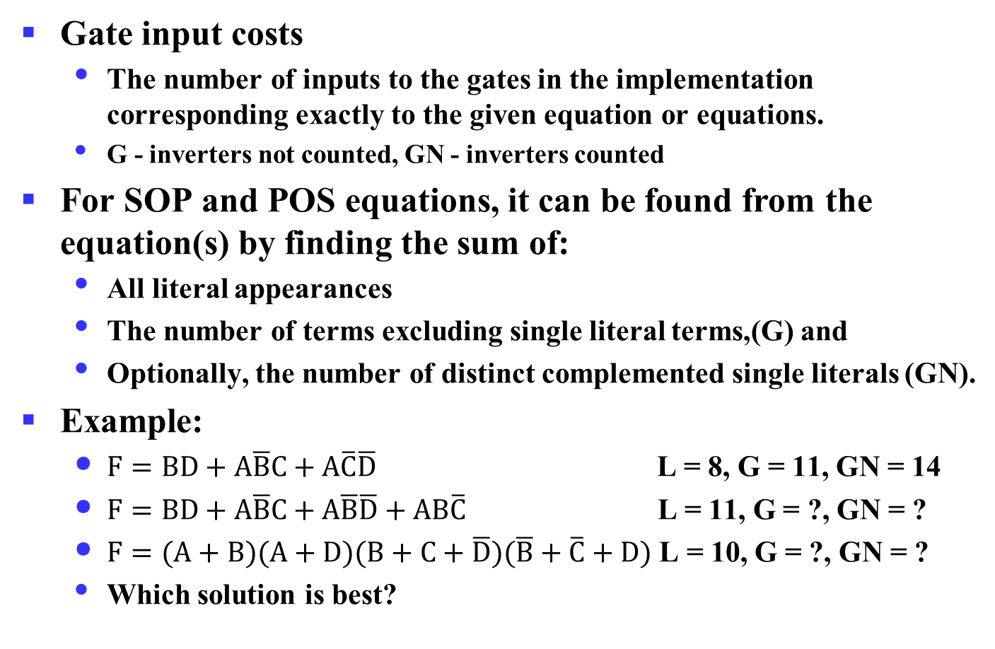
Gate Input Cost
Gate input costs
  The number of inputs to the gates in the implementation corresponding exactly to the given equation or equations.
  G - inverters not counted, GN - inverters counted
For SOP and POS equations, it can be found from the equation(s) by finding the sum of:
  All literal appearances
  The number of terms excluding single literal terms,(G) and
  Optionally, the number of distinct complemented single literals (GN).
Example:
  $F=BD+A\overline{B}C+A\overline{C}\overline{D}$ L = 8, G = 11, GN = 14
  $F=BD+A\overline{B}C+A\overline{B}\overline{D}+AB\overline{C}$ L = 11, G = ?, GN = ?
  $F=(A+B)(A+D)(B+C+\overline{D})(\overline{B}+\overline{C}+D)$ L = 10, G = ?, GN = ?
  Which solution is best?
Notes:
门输入成本，所用门的输入端的个数。
G = 15, GN = 18
G = 14, GN = 17
1st solution is best

Slide 86
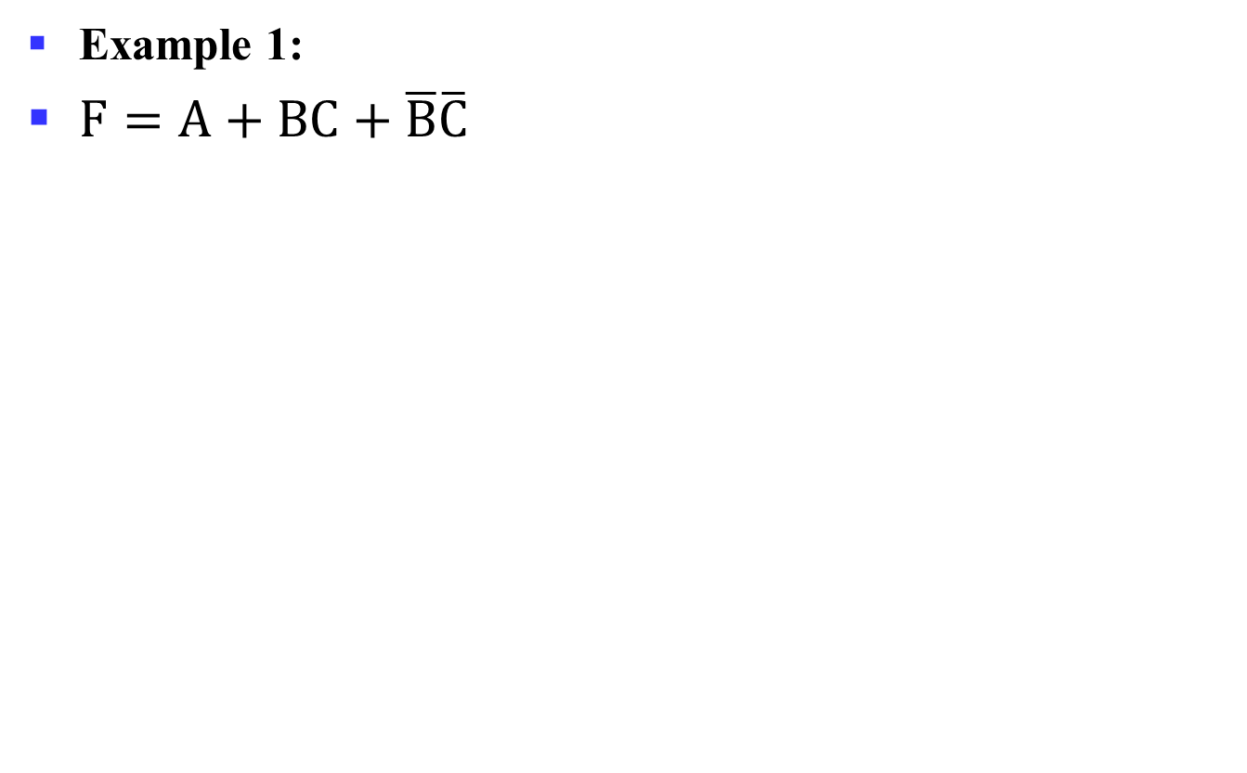
Cost Criteria (continued)
Example 1:
$F=A+BC+\overline{B}\overline{C}$
GN = G + 2 = 9
L = 5
G = L + 2 = 7
B
C
A
F
L (literal count) counts the AND inputs and the single literal OR input
G (gate input count) adds the remaining OR gate inputs
GN(gate input count with NOTs) adds the inverter inputs

Slide 87
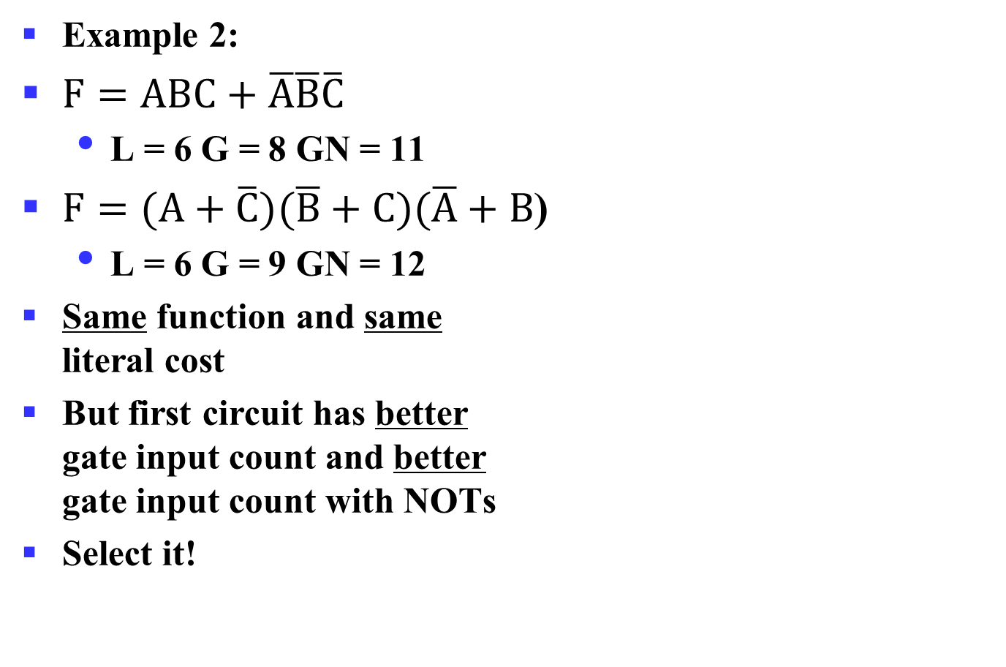
Cost Criteria (continued)
A
Example 2:
$F=ABC+\overline{A}\overline{B}\overline{C}$
  L = 6 G = 8 GN = 11
$F=(A+\overline{C})(\overline{B}+C)(\overline{A}+B$)
  L = 6 G = 9 GN = 12
Same function and same
literal cost
But first circuit has better
gate input count and better
gate input count with NOTs
Select it!
B
C
F
A
B
C
F

Slide 88
Boolean Function Optimization
Minimizing the gate input (or literal) cost of a (a set of) Boolean equation(s) reduces circuit cost.
We choose gate input cost.
Boolean Algebra and graphical techniques are tools to minimize cost criteria values.
Some important questions:
  When do we stop trying to reduce the cost?
  Do we know when we have a minimum cost?
Treat optimum or near-optimum cost functions
for two-level (SOP and POS) circuits first.
Introduce a graphical technique using Karnaugh maps (K-maps, for short)

Slide 89
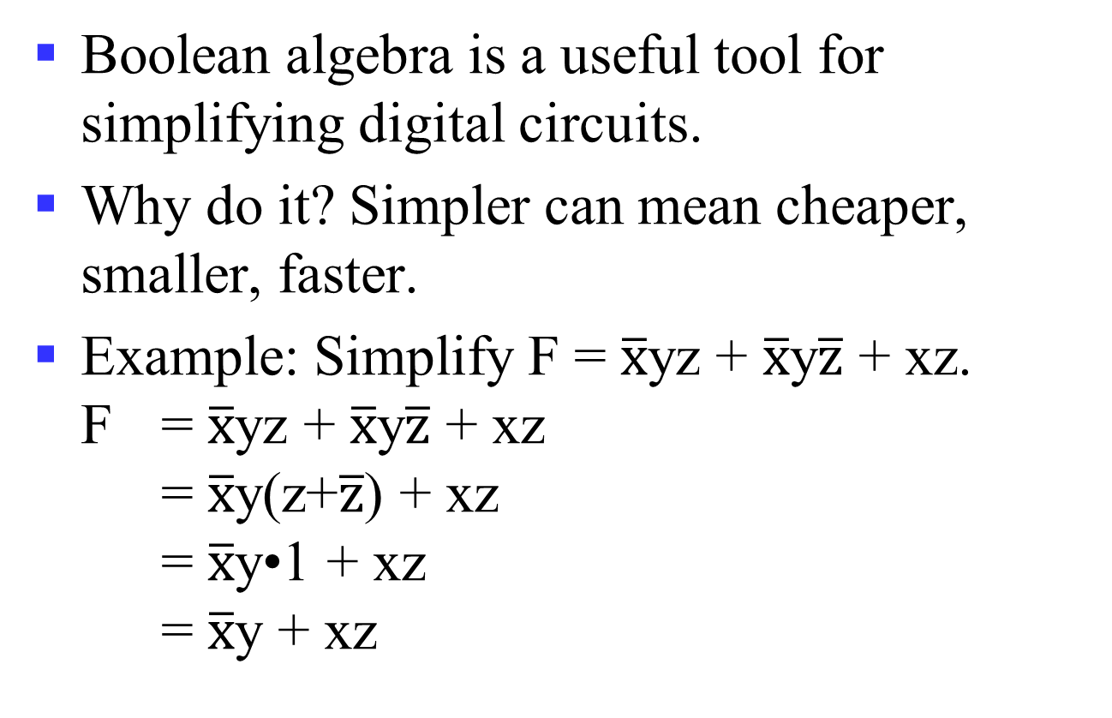
Algebraic Manipulation
Boolean algebra is a useful tool for simplifying digital circuits.
Why do it? Simpler can mean cheaper, smaller, faster.
Example: Simplify F = $\overline{x}$yz + $\overline{x}$y$\overline{z}$ + xz.
F = $\overline{x}$yz + $\overline{x}$y$\overline{z}$ + xz
= $\overline{x}$y(z+$\overline{z}$) + xz
= $\overline{x}$y•1 + xz
= $\overline{x}$y + xz

Slide 90
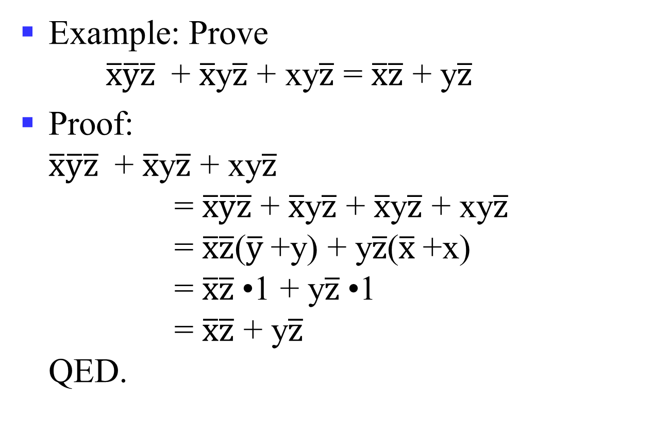
Algebraic Manipulation (cont.)
Example: Prove
$\overline{x}\overline{y}\overline{z}$ + $\overline{x}$y$\overline{z}$ + xy$\overline{z}$ = $\overline{x}\overline{z}$ + y$\overline{z}$
Proof:
$\overline{x}\overline{y}\overline{z}$ + $\overline{x}$y$\overline{z}$ + xy$\overline{z}$
= $\overline{x}\overline{y}\overline{z}$ + $\overline{x}$y$\overline{z}$ + $\overline{x}$y$\overline{z}$ + xy$\overline{z}$
= $\overline{x}\overline{z}$($\overline{y}$+y) + y$\overline{z}$($\overline{x}$+x)
= $\overline{x}\overline{z}$•1 + y$\overline{z}$•1
= $\overline{x}\overline{z}$ + y$\overline{z}$
QED.

Slide 91
A Quiz
F(X, Y, Z) = ∑ m(1, 2, 4, 6) ?
Notes:
F(X, Y, Z) = ∑ m(1, 2, 4, 6)
= X’ · Y’ · Z + X’ · Y · Z’ + X · Y’ · Z’ + X · Y · Z’
= X’ · Y’ · Z + X’ · Y · Z’ + (X · Y’ · Z’ + X · Y · Z’)
= X’ · Y’ · Z + X’ · Y · Z’ + X · Z’
= X’ · Y’ · Z + (X’ · Y + X) · Z’
= X’ · Y’ · Z + (X + Y) · Z’
= X’ · Y’ · Z + X · Z’ + Y · Z’

Slide 92
Yet Another One
A Simplification Example:
Writing the minterm expression:
F = A B C + A B C + A B C + ABC + ABC
Simplifying:
F =
Notes:
F = A’ B’ C + A (B’ C’ + B C’ + B’ C + B C)
= A’ B’ C + A (B’ + B) (C’ + C)
= A’ B’ C + A.1.1
= A’ B’ C + A
= B’C + A --- Distributive Law: X + YZ = (X+Y)(X+Z)
Simplified F contains 3 literals compared to 15 in minterm F

Slide 93
The Benefit
The two implementations for F are shown below – it is quite apparent which is simpler!

Slide 94
Karnaugh Maps (K-map)
A K-map is a collection of squares (2K). And each square represents a Minterm. Adjacent squares differ in the value of one variable.
Karnaugh maps (K-maps) are graphical representations of boolean functions.
One map cell corresponds to a row in the truth table.
Also, one map cell corresponds to a minterm or a maxterm in the boolean expression
Multiple-cell areas of the map correspond to standard terms.
Notes:
布尔表达式化简过程不是那么容易，函数可以有多种形式，没有规则指导下一步。

Slide 95
N-Variable Karnaugh Map
Matrix with 2^{n} cells
  E.g., 2-variables, 3-variables and 4-variables
W
X
X
WX
 | 00 | 01 | 11 | 10
00 | m₀ | m₄ | m₁₂ | m₈
01 | m₁ | m₅ | m₁₃ | m₉
11 | m₃ | m₇ | m₁₅ | m₁₁
10 | m₂ | m₆ | m₁₄ | m₁₀
X
XY
YZ
 | 0 | 1
0 | m₀ | m₂
1 | m₁ | m₃
 | 00 | 01 | 11 | 10
0 | m₀ | m₂ | m₆ | m₄
1 | m₁ | m₃ | m₇ | m₅
Y
Z
Y
Z
Z
Y
Y
X
Notes:
不多于4变量的化简用卡诺图是较好的方法，函数在途中可被看成所有使函数取值为1的方格，其对应的最小项包含在函数中。
进一步地，卡诺图本质上是对一个函数所有可能地标准表示方式的图形化，通过相邻项合并求最优的表达。卡诺图可用于2级电路的优化，不能直接用于更多级的电路。

Slide 96
Some Uses of K-Maps
Finding optimum or near optimum
  SOP and POS standard forms, and
  two-level AND/OR and OR/AND circuit implementations
for functions with small numbers of variables
Visualizing concepts related to manipulating Boolean expressions, and
Demonstrating concepts used by computer-aided design programs to simplify large circuits

Slide 97
Principles of Optimization with K-Map
Since AB+AB=A, two adjacent minterms can be merged into one term to eliminate the redundant variable.
In K-Map, the adjacent squares (each square refer to one minterm in the Boolean function) can be combined in similar way. And the combined squares are called Karnaugh Circles.
Finding adjacent squares is very important in simplification with K-Map.
  The number of adjacent squares in Karnaugh Circles is a power of 2.

Slide 98
Simplification of Logic Functions
Example: F(X, Y, Z) = ∑ m(3, 5, 6, 7)
X
Index | X Y Z | F(X, Y, Z)
0 | 0 0 0 | 0
1 | 0 0 1 | 0
2 | 0 1 0 | 0
3 | 0 1 1 | 1
4 | 1 0 0 | 0
5 | 1 0 1 | 1
6 | 1 1 0 | 1
7 | 1 1 1 | 1
XY
 | 00 | 01 | 11 | 10
0 |  |  | 1
1 |  | 1 | 1 | 1
Z
Z
Y
XY
X · Y
 | 00 | 01 | 11 | 10
0 |  |  | 1
1 |  | 1 | 1 | 1
Z
X · Z
Y · Z

Slide 99
K-Map Definitions
Implicant
  Product of literals ABC, AC, BC
Prime implicant
  Implicant corresponding to the largest circle in a K-map, i.e., is a product term obtained by combining the maximum possible number of adjacent squares in the map into a rectangle with the number of squares a power of 2.
Essential prime implicant
  A prime implicant is called an Essential Prime Implicant if it is the only prime implicant that covers (includes) one or more minterms.
Notes:
Implicant：蕴涵项，如果一个乘积项包含了一个或多个最小项，那么称之为蕴涵项
Prime implicant：质蕴涵项，如果某个蕴涵项不能被该函数的其它蕴涵项所覆盖，则称为质蕴涵项
Essential prime implicant：实质蕴涵项，质蕴涵项覆盖的最小项中至少有一个最小项没有被其它质蕴涵项覆盖
如果逻辑函数的所有最小项都能被一组质蕴涵项覆盖，则该组质蕴涵项称为函数的一个覆盖，一定包含了所有的实质蕴涵项
F(A, B, C) = sigma m(1, 3, 4, 5, 7)

Slide 100
K-Map Rules
Every 1 must be circled at least once
Each circle must span a power of 2 (i.e., 1, 2, 4) squares in each direction
Each circle must be as large as possible
A circle may wrap around the edges
A “don't care” (X) is circled only if it helps minimize the equation
Notes:
A Prime Implicant is a product term obtained by combining the maximum possible number of adjacent squares in the map into a rectangle with the number of squares a power of 2.
A set of prime implicants "covers all minterms" if, for each minterm of the function, at least one prime implicant in the set of prime implicants includes the minterm.

Slide 101
Example of Prime Implicants
Find ALL Prime Implicants
CD
ESSENTIAL Prime Implicants
C
C
B
D
B
D
1
1
1
1
1
1
BD
1
1
BD
1
1
B
B
1
1
1
1
A
A
A
B
1
1
1
1
1
1
1
1
D
D
AD
B
C
Minterms covered by single prime implicant

Slide 102
Prime Implicant Practice
Find all prime implicants for:
Notes:
Prime implicants are: A, B'C, and B'D'

Slide 103
Prime Implicant Selection Rule
Minimize the overlap among prime implicants as much as possible.
In particular, in the final solution, make sure that each prime implicant selected includes at least one minterm not included in any other prime implicant selected.

Slide 104
Selection Rule Example
Simplify F(A, B, C, D) given on the K-map
Selected
Essential
C
C
1
1
1
1
1
1
1
1
1
1
1
1
B
B
1
1
A
A
1
1
1
1
D
D
Minterms covered by essential prime implicants

Slide 105
An Example of 4-Variable K-Map

Slide 106
An Example of 4-Variable K-Map

Slide 107
Selection Rule Example with Don't Cares
Simplify F(A, B, C, D) given on the K-map
Selected
Essential
C
C
1
x
1
x
1
x
x
1
1
x
x
1
B
B
x
x
A
A
1
1
x
1
1
x
D
D
Minterms covered by essential prime implicants
Notes:
某些场景某些输入组合不关心，函数输出结果不确定，不完全确定函数(incompletely specified function)。
不确定的最小项称为无关最小项(don’t care condition)，可使得卡诺图进一步化简。

Slide 108
An Example with Don’t Cares

Slide 109
An Example with Don’t Cares

Slide 110
Systematic Simplification
Example: ∑ _{m}(1, 2, 5, 7, 8, 10, 12, 13, 15)
AB
AB
AB
 | 00 | 01 | 11 | 10
00 |  |  | 1 | 1
01 | 1 | 1 | 1
11 |  | 1 | 1
10 | 1 |  |  | 1
 | 00 | 01 | 11 | 10
00 |  |  | 1 | 1
01 | 1 | 1 | 1
11 |  | 1 | 1
10 | 1 |  |  | 1
 | 00 | 01 | 11 | 10
00 |  |  | 1 | 1
01 | 1 | 1 | 1
11 |  | 1 | 1
10 | 1 |  |  | 1
CD
CD
CD
Notes:
F(A,B,C,D) = BD + A’CD+ B’CD’+AC’D’

Slide 111
Systematic Simplification
F(W,X,Y,Z) = ∑ _{m}(3, 4, 5, 7, 9, 13, 14, 15) ?
Notes:
Q = XZ
P = W' X Y’ + WY’Z + W' Y Z + WXY
F = Q + P
Q == XZ(W+W’)(Z+Z’)
F = XZ(W+W’)(Z+Z’) + P = P

Slide 112
Results May NOT Be Unique
F(X, Y, Z) = XZ’ + X’Z + YZ’ + Y’Z
F(X, Y, Z) = ∑ _{m}?
?
Notes:
F(X,Y,Z) = X’Y’Z + X’YZ’+ X’YZ + XY’Z’ + XY’Z + XYZ’
= ∑ _{m}(1, 2, 3, 4, 5, 6)
F(X,Y,Z) = X’Z + XY’ + YZ’
F(X,Y,Z) = X’Y + XZ’+ Y’Z

Slide 113
DeMorgan’s Theorem Can Be Useful
Y = AB = A + B
Y = A + B = A B

Slide 114
Bubble Pushing
Backward:
  Body changes
  Adds bubbles to inputs
Forward:
  Body changes
  Adds bubble to output

Slide 115
Bubble Pushing
What is the Boolean expression for this circuit?
Y = AB + CD

Slide 116
Bubble Pushing Rules
Begin at output, then work toward inputs
Push bubbles on final output back
Draw gates in a form so bubbles cancel

Slide 117
Bubble Pushing Example

Slide 118
Bubble Pushing Example

Slide 119
Bubble Pushing Example

Slide 120
Bubble Pushing Example

Slide 121
Multiple-Level Optimization
Multiple-level circuits - circuits that are not two-level (with or without input and/or output inverters)
Multiple-level circuits can have reduced gate input cost compared to two-level (SOP and POS) circuits
Multiple-level optimization is performed by applying transformations to circuits represented by equations while evaluating cost

Slide 122
Optimization Example
Optimize the function through transformations, and reduce the gate input cost.
Example: Optimize these multi-level Boolean functions:
(a) gate input cost: 17;
(b) gate input cost: 13;
(c) gate input cost: 12;
(d) gate input cost: 9

Slide 123
Overview
Introduction
Binary logic and gates
Transistors
Some IC parameters
Boolean algebra
Logic functions
Simplification of logic functions
Additional Gates and Circuits

Slide 124
Exclusive OR/ Exclusive NOR
The eXclusive OR (XOR) function is an important Boolean function used extensively in logic circuits.
The XOR function may be;
    implemented directly as an electronic circuit (truly a gate) or
    implemented by interconnecting other gate types (used as a convenient representation)
The eXclusive NOR function is the complement of the XOR function
By our definition, XOR and XNOR gates are complement gates.

Slide 125
Truth Tables for XOR/XNOR
X
Y
X
⊕
Y
X
Y
(X
⊕
Y)
Operator Rules:
The XOR function means:
X OR Y, but NOT BOTH
or X
≡
Y
XOR
0
0
0
0
0
1
0
1
1
0
1
0
1
0
1
1
0
0
1
1
0
1
1
1
X
⊕
Y
=
X
Y
+
X
Y
XNOR
X
⊕
Y
=
X
Y
+
X
Y

Slide 126
XOR Implementations
The simple SOP structure:
A implementation with just NAND is:
  What’s the expression?
  What’s the logic graph?
X
X
⊕
Y
=
X
Y
+
X
Y
X
Y
Y
X
X
Y
Y

Slide 127
Application of XOR/XNOR
XOR / XNOR
  Adders / subtractors / multipliers
  Counters / incrementers / decrementers
  Parity generators / checkers

Slide 128
XOR Identities
X
⊕
0
=
X
X
⊕
1
=
X
X
⊕
X
=
0
X
⊕
X
=
1
X
⊕
Y
=
Y
⊕
X
(
X
⊕
Y
)
⊕
Z
=
X
⊕
(
Y
⊕
Z
)
=
X
⊕
Y
⊕
Z
The complement of the odd function is the even function.
Symbol ⊕ can be replaced by other Boolean equivalence.

Slide 129
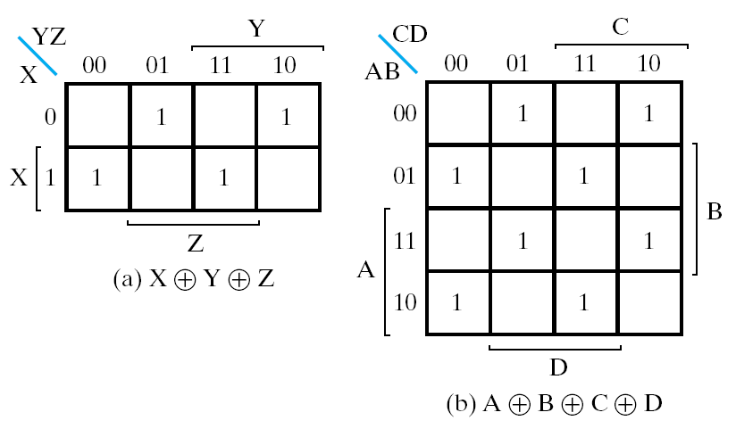
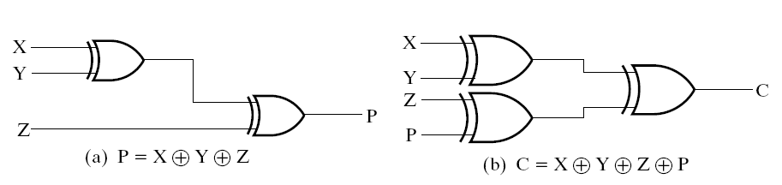
XOR function extended to 3 or more variables.

Slide 130
Parity Generators and Checkers
Parity Generators and Checkers
Parity bit
  a parity bit added to n-bit code to produce an n + 1 bit code
  Add odd parity bit to generate code words with even parity
  Add even parity bit to generate code words with odd parity
Example: n = 3. Generate even parity code words of length 4 with odd parity generator
(X,Y,Z) = (0,0,1) gives
(X,Y,Z,P) = (0,0,1,1) and E = 0.
Generator: generator parity bit
Checker: check the change of received data, for example:
  If Y changes from 0 to 1 between generator and checker, then E = 1 indicates an error.

Slide 131
Parity Generators and Checkers
Even parity checker in the right circuit
P
  parity generator
  Xyz has odd 1，P=1
  Xyz has even 1，P=0
E
  parity checker
  E=0，OK
  E=1，Error
X
Y
P
Z
X
Y
E
Z
P

Slide 132
Hi-Impedance Outputs
Logic gates introduced thus far
  have 1 and 0 output values
  cannot have their outputs connected together, and
  transmit signals on connections in only one direction.
Imagine:
  What will happen if the gate outputs are connected together?
Cannot Do It！
Hi-Z state - Hi-z，Hiz，HiZ

Slide 133
Hi-Impedance Outputs (continued)
What is a Hi-Z value?
  1 —— high voltage
  0 —— low voltage
  Hi-Z value —— Open circuit，disconnected.
    It is as if a switch between the internal circuitry and the output has been opened.
Hi-Z may appear on the output of any gate, but we restrict gates to:
  a 3-state buffer
  a transmission gate
Feature: each of which has one data input and one control input.

Slide 134
The 3-State Buffer
The 3-State Buffer
  Symbol and truth table
  IN, data input,
  Out， Data Output
  EN, Control input，Enabled.
EN = 0
regardless of the value on IN (denoted by X), the output value is Hi-Z.
EN = 1 OUT = IN
Variations:
  Data input, IN, can be inverted
  Control input, EN, can be inverted
Symbol
IN
OUT
EN
Truth Table
EN
IN
OUT
0
X
Hi-Z
1
0
0
1
1
1

Slide 135
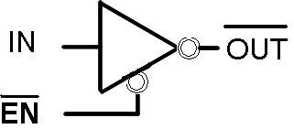
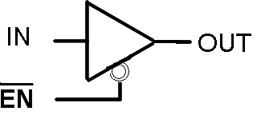
The 3-State Buffer
IN
OUT
EN

Slide 136
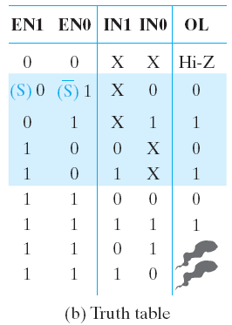
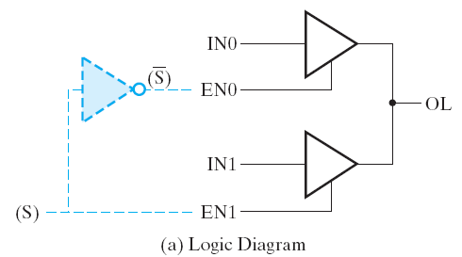
Multiplexed Line OL
Figure 2-34 Three-state Buffers Forming a Multiplexed Line OL

Slide 137
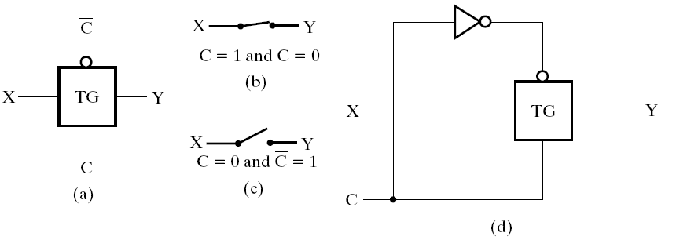
Transmission Gates
The transmission gate is one of the designs for an electronic switch for connecting and disconnecting two points in a circuit
Figure 2-35 Transmission Gates（TG）

Slide 138
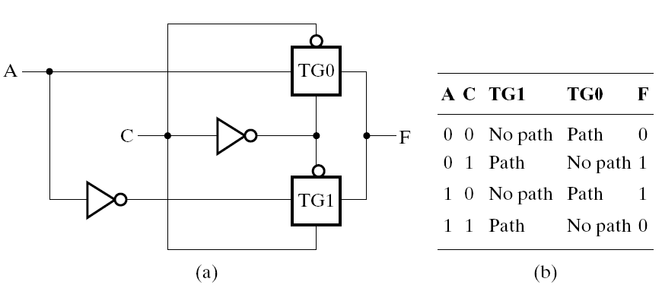
Transmission Gates
Figure 2-36 Transmission Gate Exclusive OR

Slide 139
Summary
Introduction
Binary logic and gates
Transistors
Some IC parameters
Boolean algebra
Logic functions
Simplification of logic functions
Additional Gates and Circuits

